Slide 1
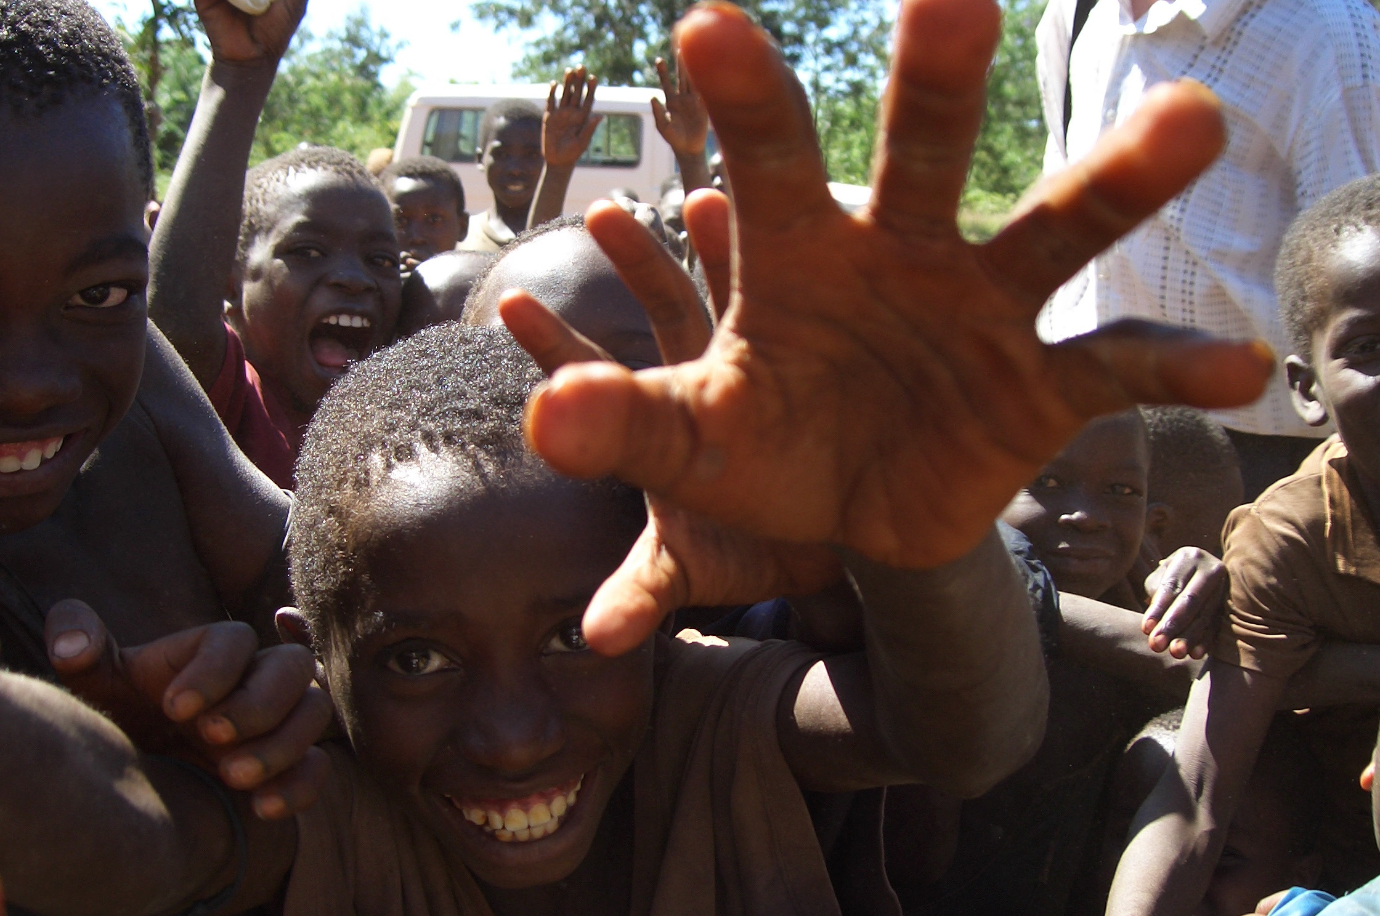


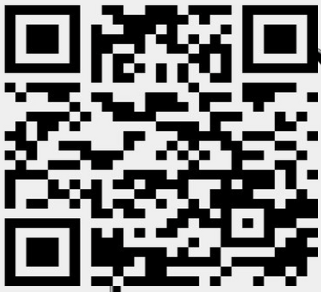
SCAN ME WITH YOUR CAMERA APP

Slide 2


DEVELOPMENT & HUMANITARIAN AGENCIES
CHRISTIAN MISSION AGENCIES

Slide 3
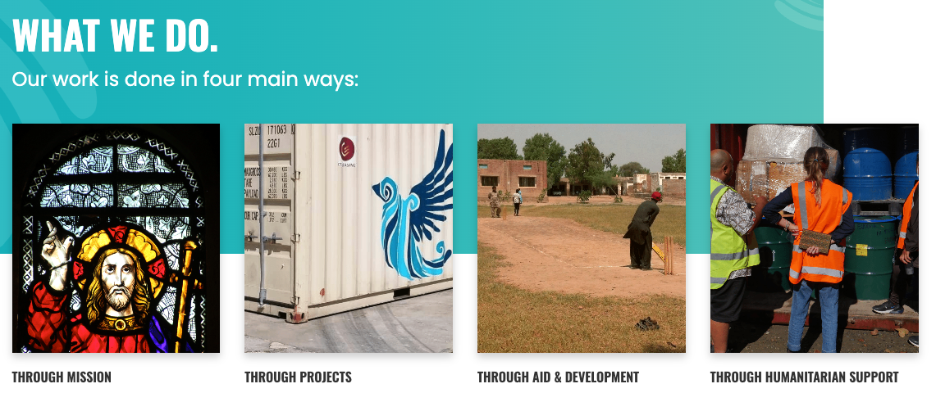

Slide 4
THE FIVE MARKS OF
MISSION
tell: Proclaim the good news of the Kingdom​
teach: Baptise and nurture new believers​
tend: Respond to human need by loving service
transform: Change societies unjust structures​
treasure: Safeguard the integrity of creation ​
​

Slide 6
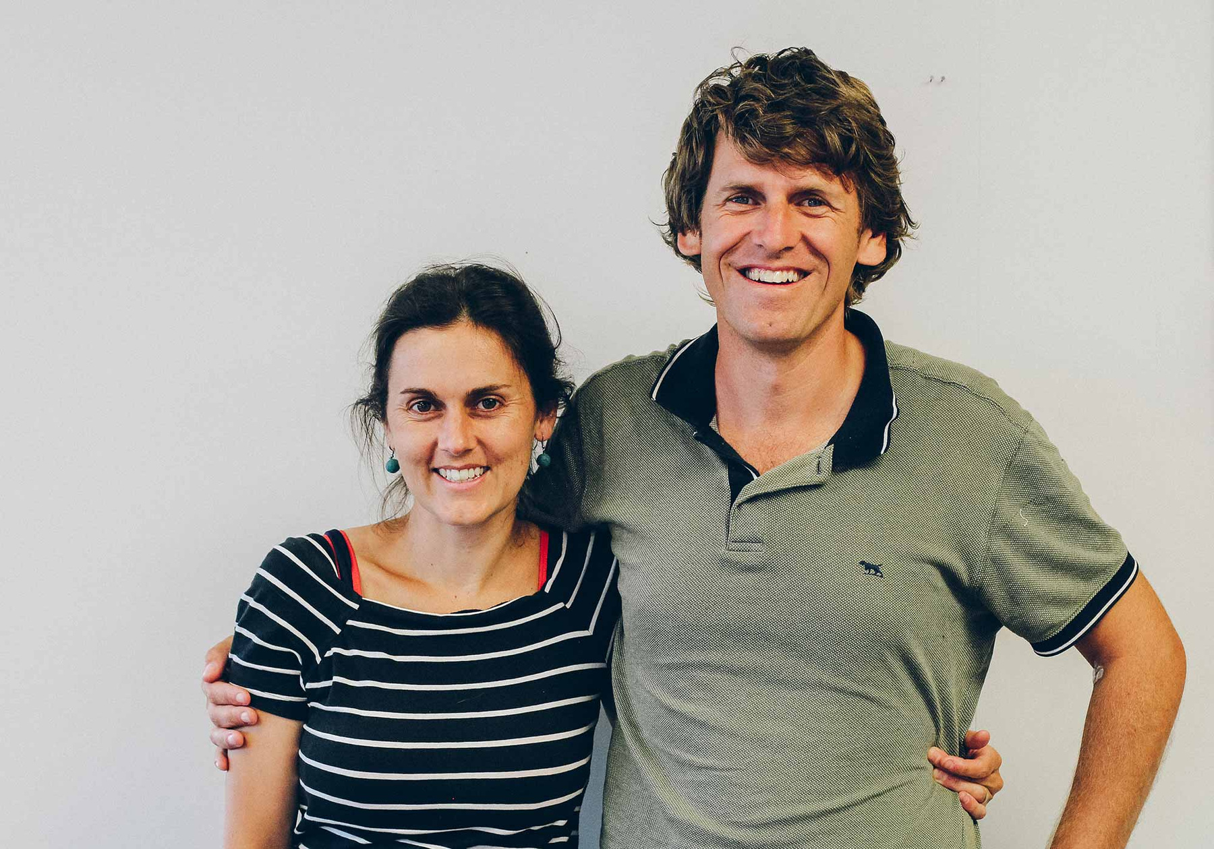
WE SUPPORT CHRISTIAN MISSION WORLDWIDE.
In 2024, we gave $436,000 to NZCMS.
That’s almost half of our annual operating budget!
Nick and Tessa Laing/ Uganda

Slide 7
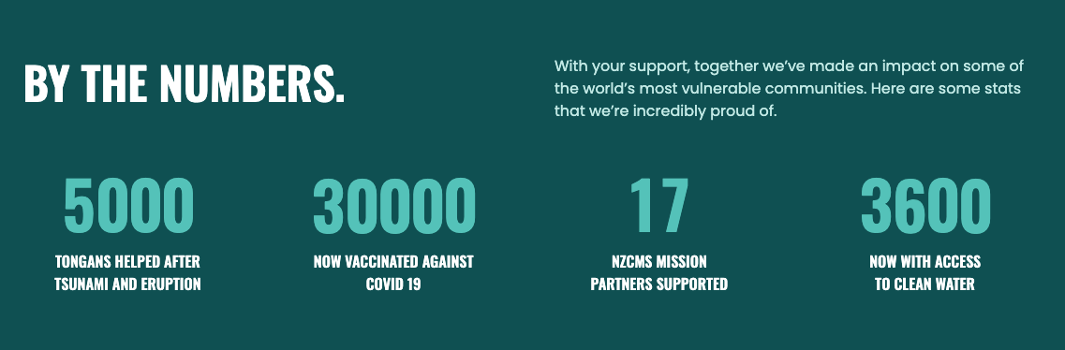

Slide 8
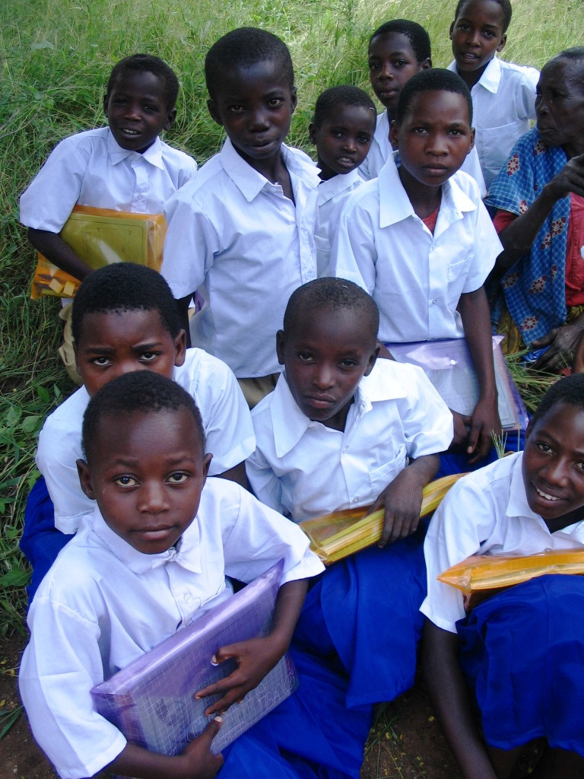



DISASTER RESILIENCE
PROJECT FOCUS
PROJECT FOCUS
WATER & SANITATION
AGRICULTURE
Notes:
This isn't just one-off emergency appeals but a commitment to ongoing support through long term development:
Al Ahli Hospital/Diocese of Jerusalem
Tonga Eruption and Tsunami Recovery
Cyclone Gabrielle Emergency Response
COVID 19 Support (Get One, Give One)
Anglican Missions coordinated the fundraising and project oversight of the Cyclone Gabrielle response.
Access to safe water and facilities is a fundamental human right. We support people to access and use it well.
Bricks for Life/Ethiopia
Water For All/Pacific
Cyclone Lola Response/Vanuatu (with Tearfund NZ)
Tonga Emergency Response/Tonga
Food isn't just about being fed, but having economic and social security. We support others to access, grow and sell nutritious food that creates flourishing communities.
Bricks for Life/Ethiopia
Rwenzori Special Needs Foundation/Uganda
Community Gardens/Fiji

Slide 9
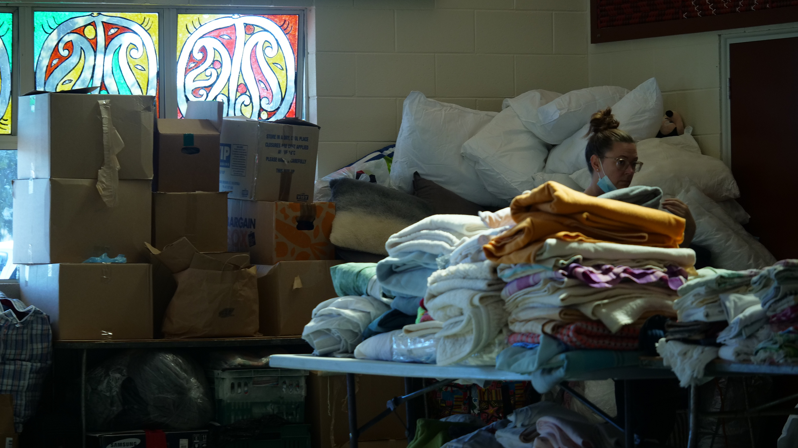
CYCLONE GABRIELLE
DISASTER RISK RESILIENCE
$420,000 raised that was distributed to 28 projects
TONGA TSUNAMI + VOLCANIC ERUPTION
donations funded:
  specialist social and mental health services for children
  building repair of evacuation centres
  building of new water tanks
  community support to aid local gardening, agriculture and fishing
HOPE FOR THE HOLY LAND
in conjuction with Anglican Overseas Aid and Anglican Alliance, we raised over $650,000 for Al Ahli Arab Hospital in Gaza - One of the only Hospitals that provides services to anyone regardless of religion

Slide 10

CYCLONE GABRIELLE
“
I could write over 100 stories of the impact the support our church has given, a support made more possible by the grant from Anglican Missions, for the community of Pakowhai.
I could write over 100 stories of the impact the support our church has given, a support made more possible by the grant from Anglican Missions, for the community of Pakowhai.
Pakowhai Support Fund, Taradale Anglican Church, Waiapu Diocese

Slide 11

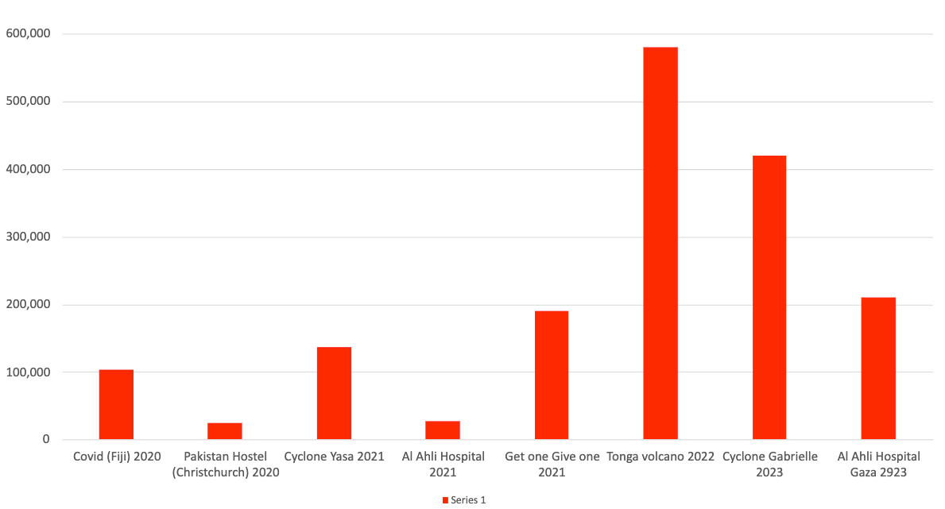
EMERGENCY APPEAL PROJECTS SUPPORTED BY 2023 DONATIONS

Slide 12
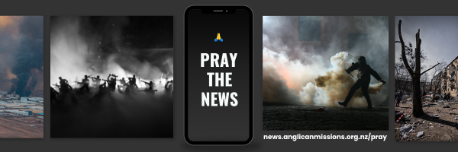

Slide 13
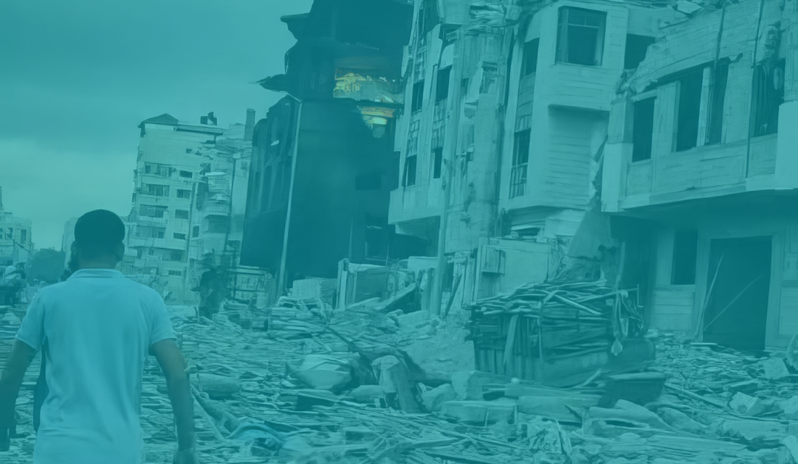

PRAY THE NEWS
The headlines are a powerful place to pray.
Pray the News is a weekly blog published by Anglican Missions to enrich the intercessory prayer life of the church as we pray into the biggest social, cultural and geopolitical headlines facing the world.
Prayer makes a difference and is an active engagement with the heart of God. Sign up to receive updates every Thursday on issues that we can pray into - together.
SCAN TO SIGN UP NOW

Slide 14
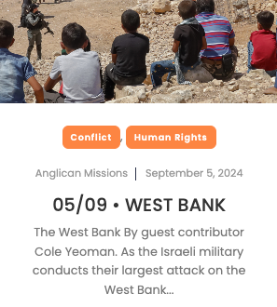
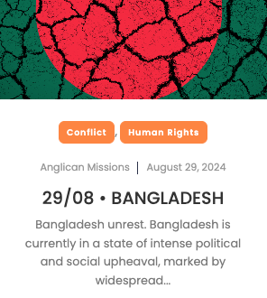
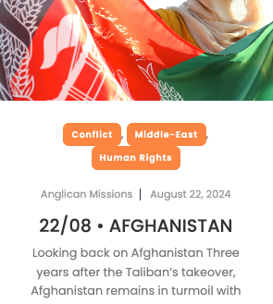
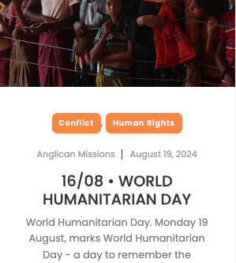
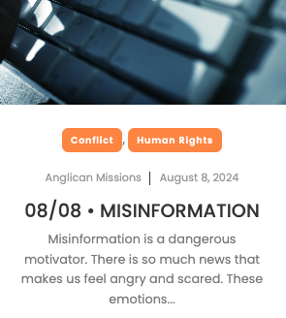
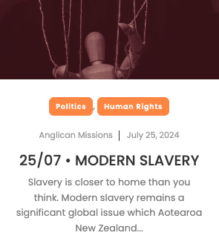
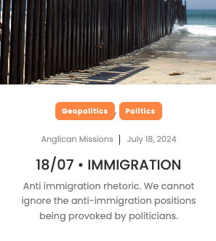
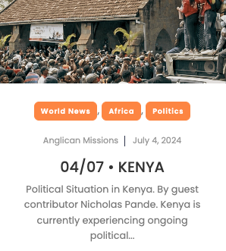

Slide 15
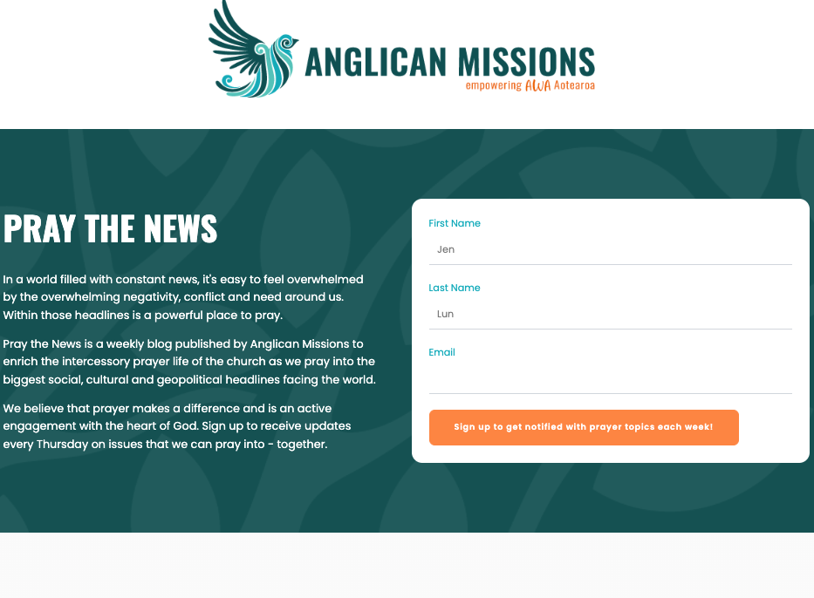
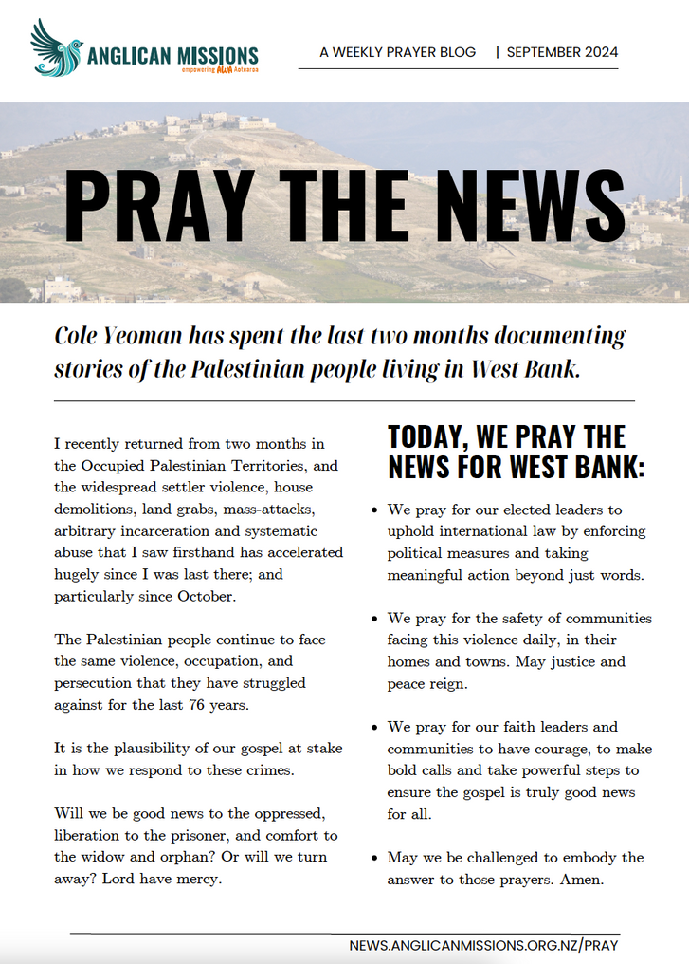

Slide 16
RWENZORI SPECIAL NEEDS FOUNDATION
RWENZORI SPECIAL NEEDS FOUNDATION

Slide 17
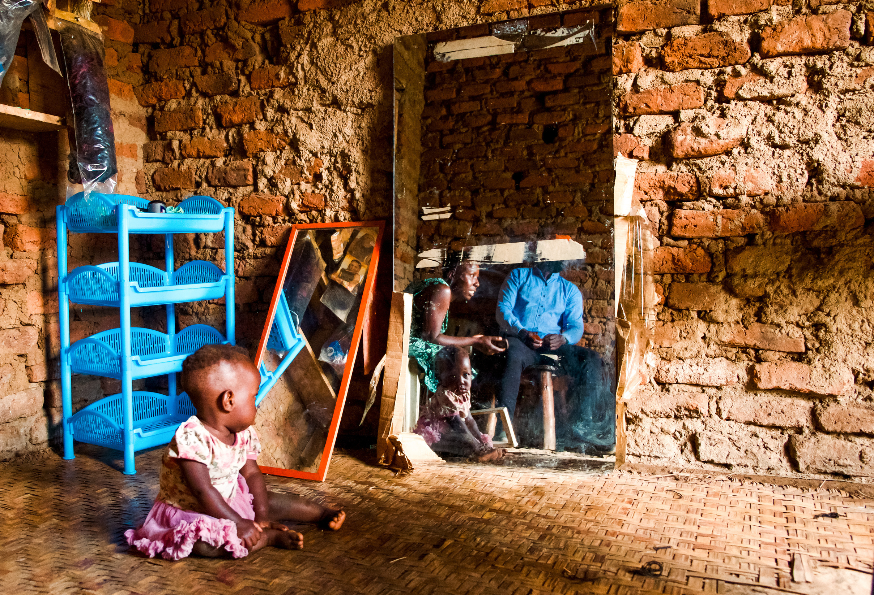
Notes:
It tells the story of Sarah, a resilient woman who lost her leg in a tragic boda boda accident in western Uganda. In that moment, she lost more than a leg and mobility. She also lost some of her hope, self-esteem, and her place in the community. Fortunately, her journey didn’t end there. Through the support of our partner, Rwenzori Special Needs Foundation , which offers accredited vocational training to people living with disability. Sarah learned business management, hairdressing, and beauty skills—tools that helped her rebuild her life.
Today, Sarah has a thriving hairdressing business, enabling her to support herself and her two children. She’s regained her smile, her pride, and her position within her community. She is also able to support her first child to go to school with the money she earns
In this image, Sarah’s second child gazes into a mirror, seeing her mother share her story with Daniel from the Foundation. To me, this image reflects not just a mother’s resilience but a daughter’s future filled with hope, as Sarah now dreams of sending her second daughter to school once she is old enough.
To me this photo is talks to the power of hope, community, and the transformative impact of giving people the tools to rebuild not just their own lives but to subsequent generations.

Slide 18
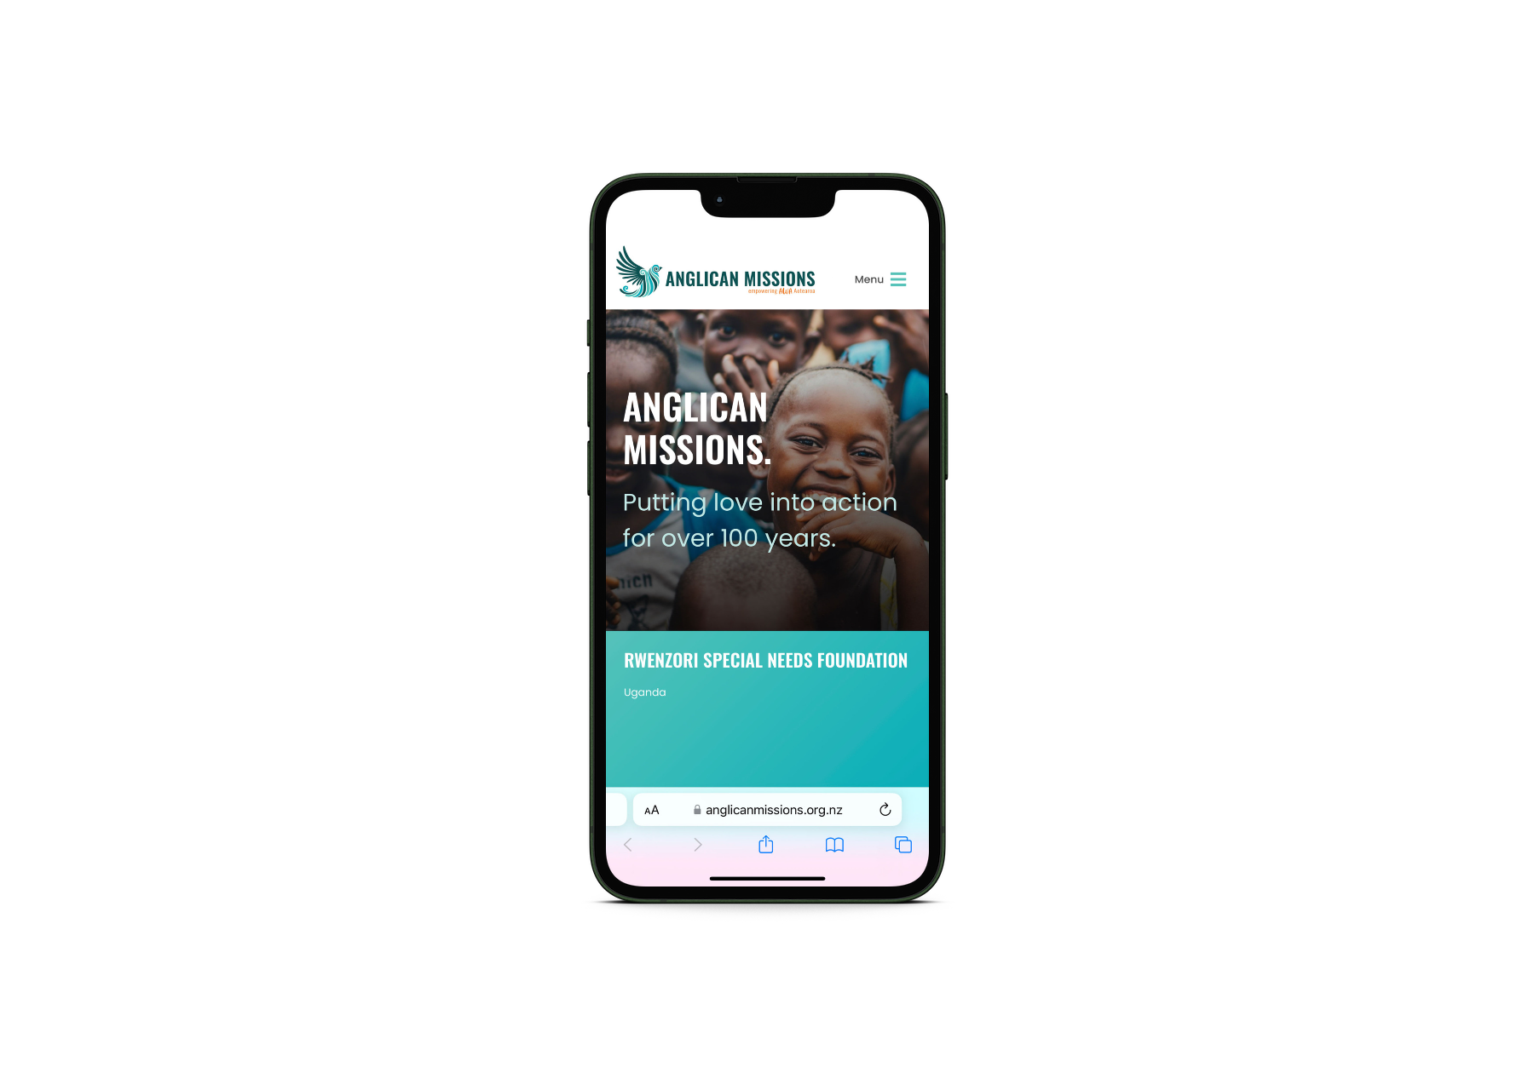

CONNECT
WITH US!
Don’t miss out on what’s happening! There’s a range of ways you can stay connected to Anglican Missions:
Find us online:
Scan the QR code to connect through our social media, website and eNewsletter.
It’s the best way to stay in the loop!

Slide 19
ANGLICAN MISSIONS
THANK YOU FOR YOUR SUPPORT.
We can’t do this work without your continued financial and prayer support.

