Slide 1
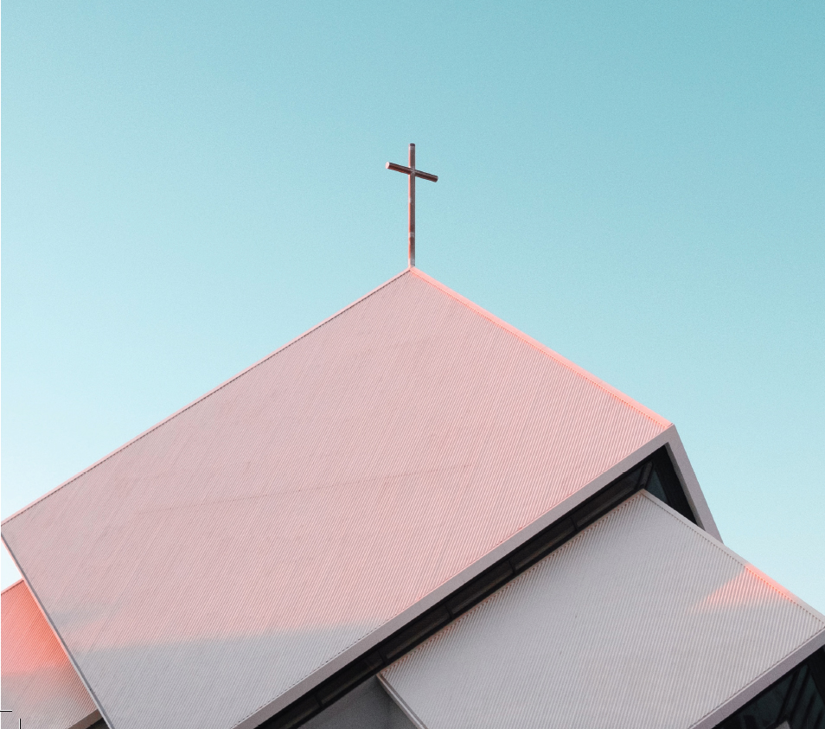
Church Life Survey
20,357 NZ Christians
Responsibility to care for environment 95%
18% Very active

Slide 2
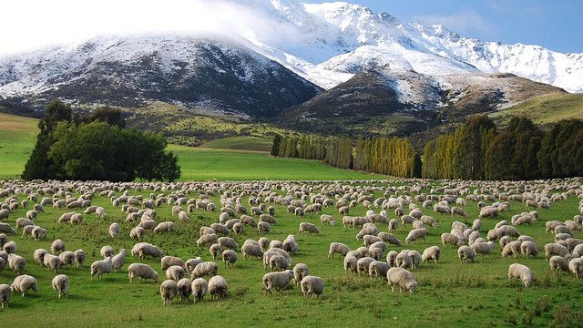
Ninety nine

Slide 3
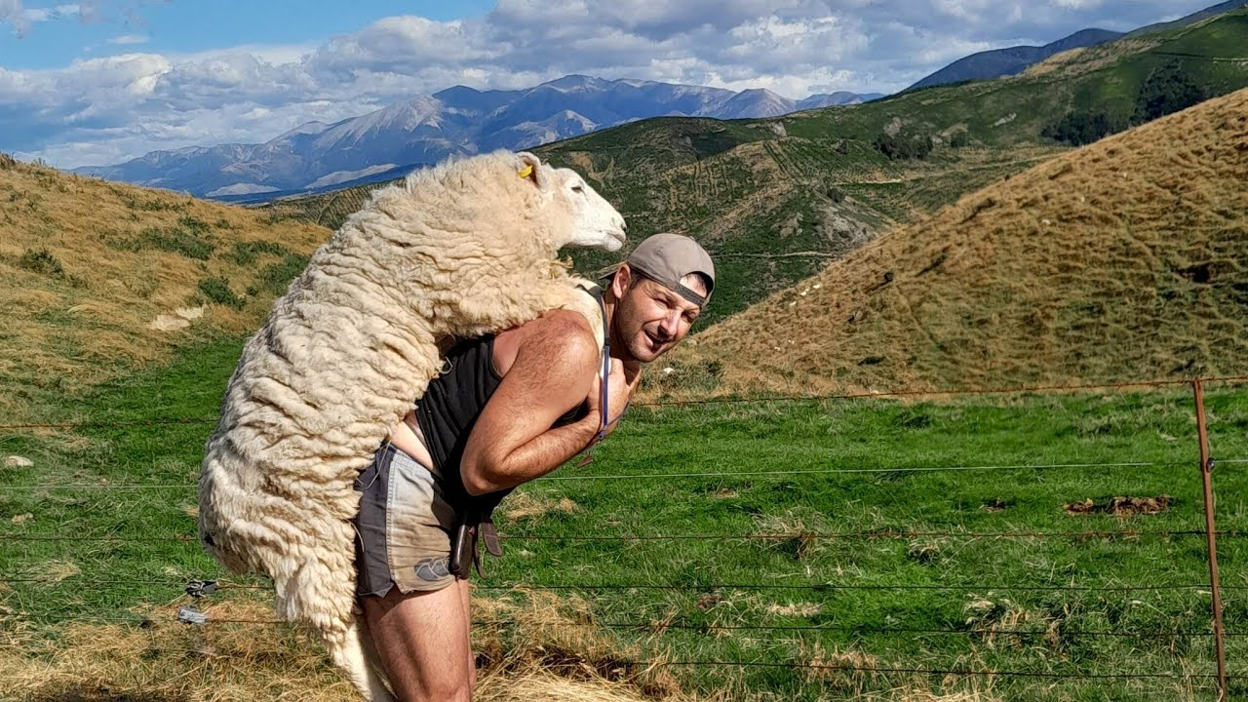
Plus one

Slide 4
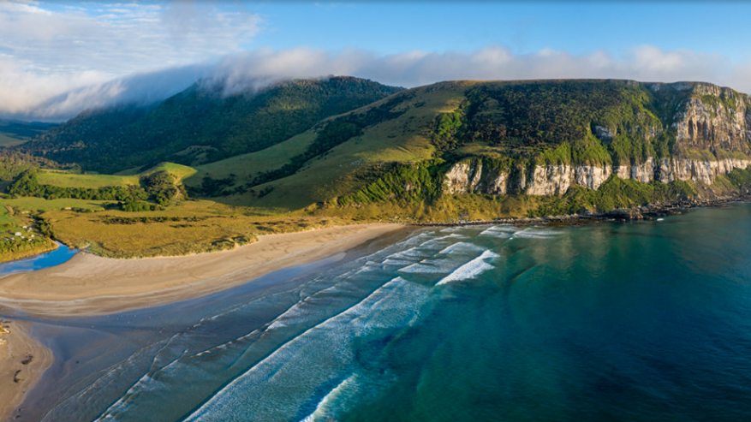
Climate resilience meets church resilience
Inspiration for Southland and Otago
from the Diocese of Polynesia

Slide 5
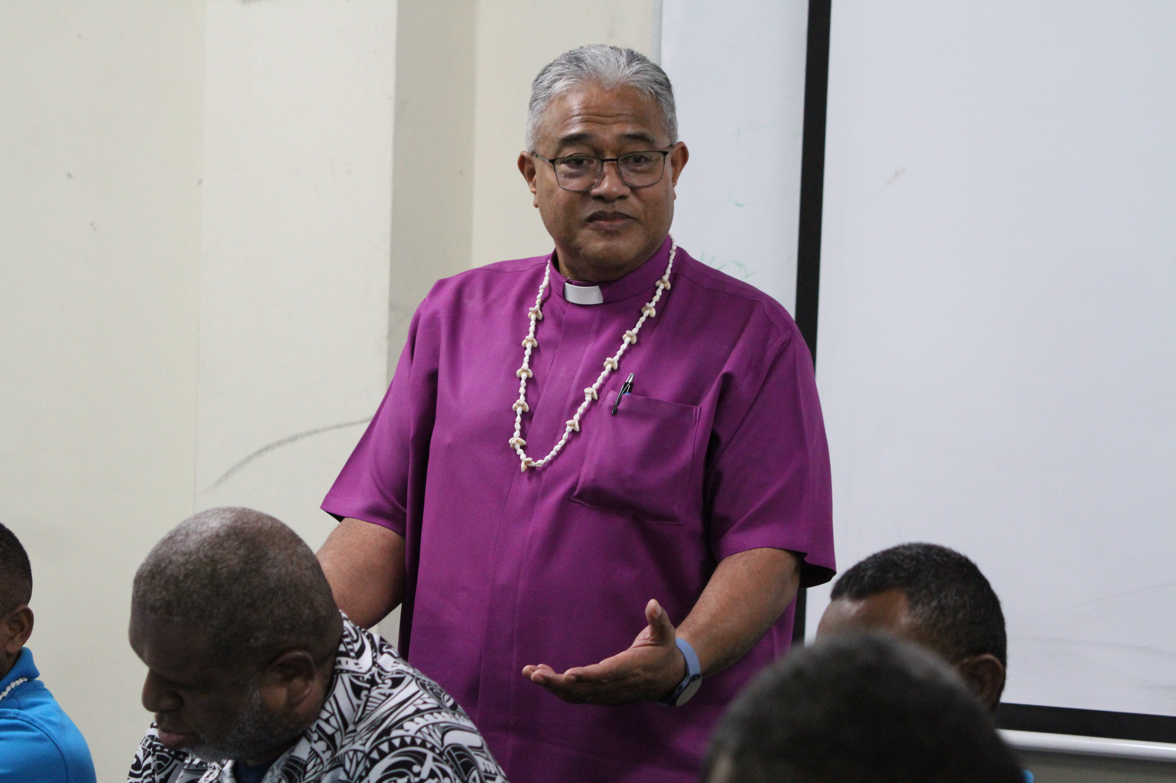
Moana Water of Life challenge: Becoming safe and resilient churches
Safe and resilient churches know us, uphold us and help protect us in our times of crisis.

Slide 6
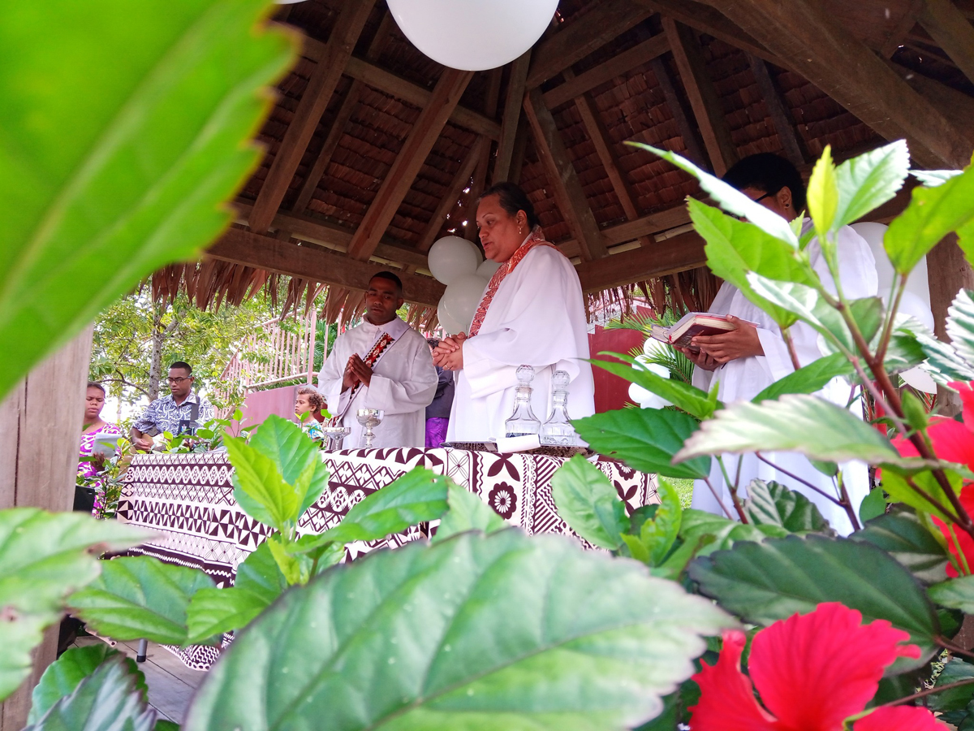
It starts with prayer
#Season of Creation September 1 – October 4
Each church in Polynesia thanks God for Creation with an annual ecumenical service (often outdoors, they invite other churches to take part)

Slide 7
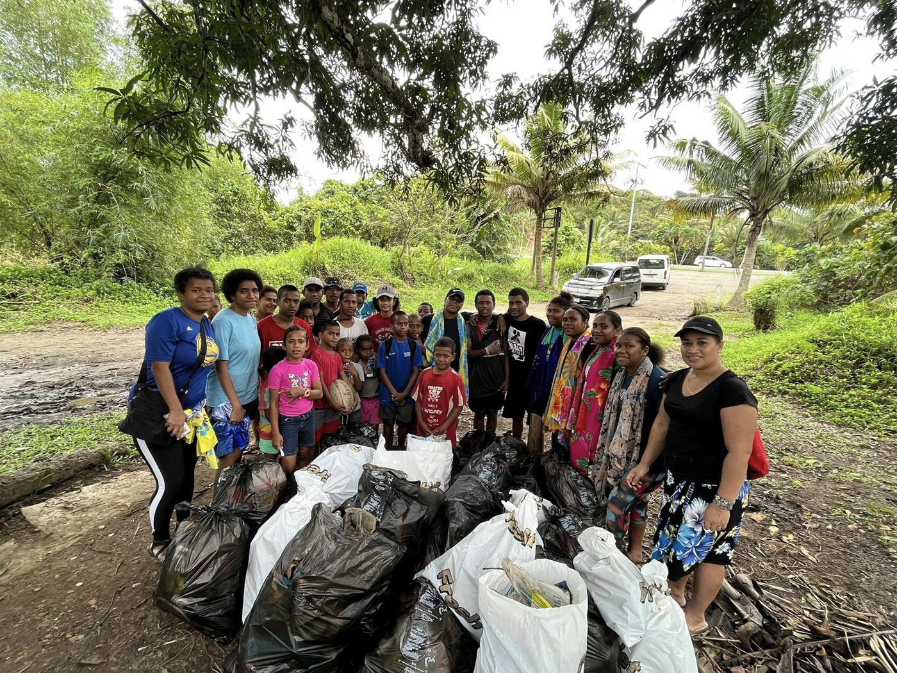
Every Anglican parish in Polynesia
Joins with their community to directly care for Creation
Removing rubbish from waterways
Planting new trees

Slide 8
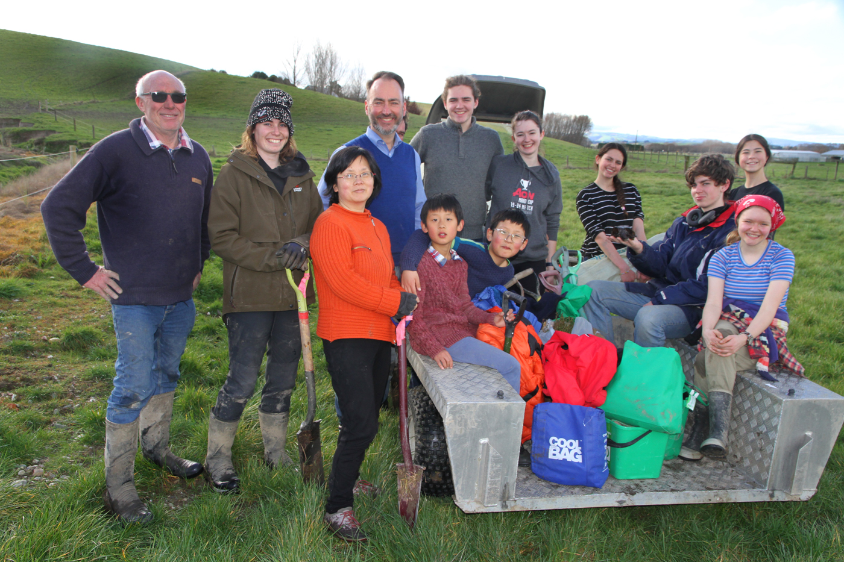
We can do it!

Slide 9

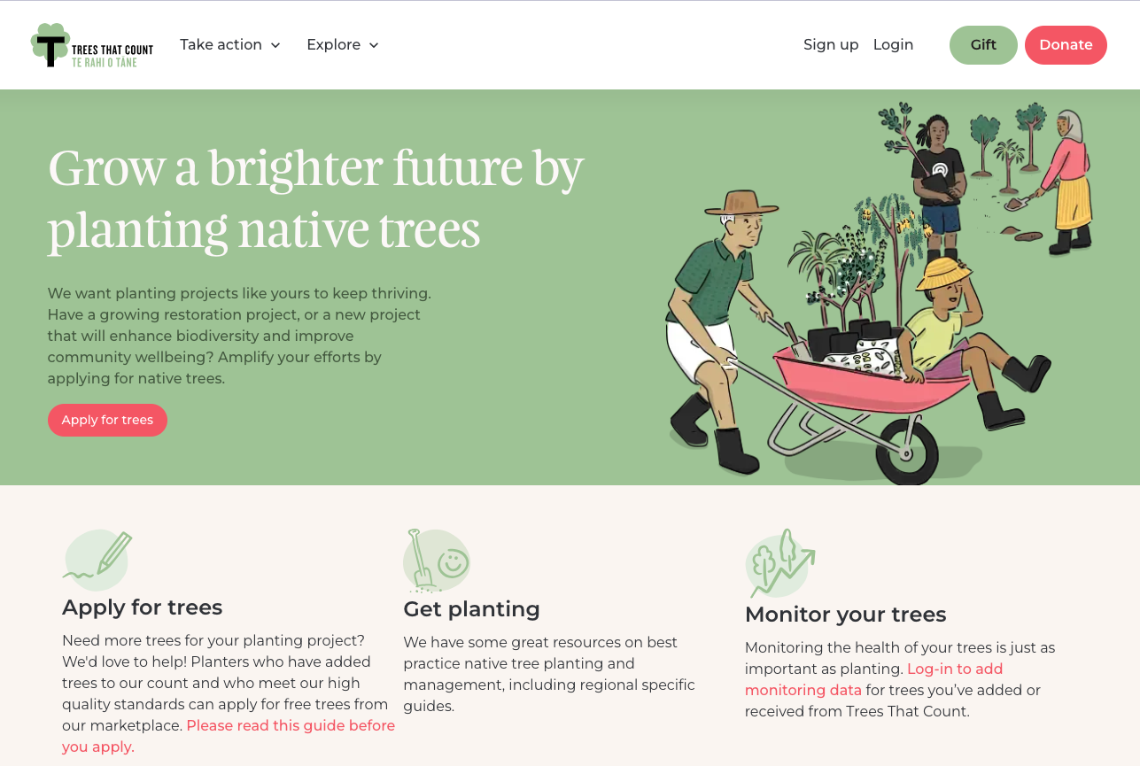
Gather or join?

Slide 10

How does climate resilience help church resilience here in Otago-Southland?
Shared values
Opportunity for leadership
License to operate
Evangelism

Slide 11
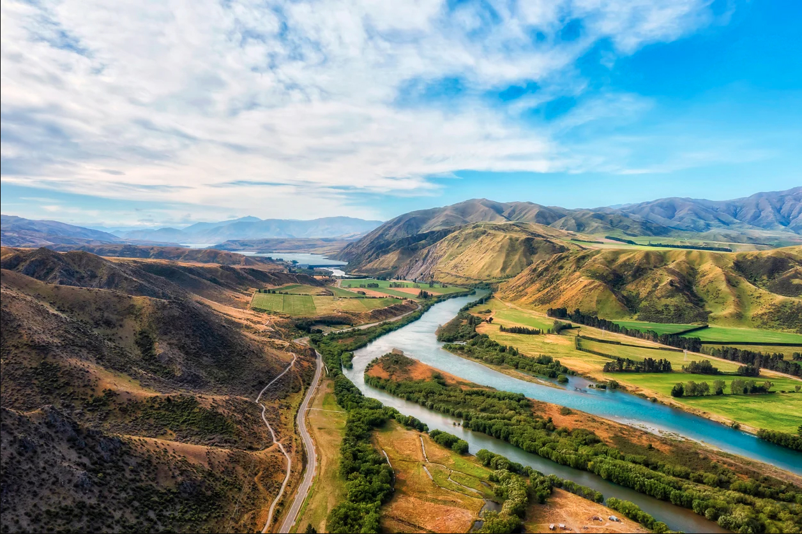
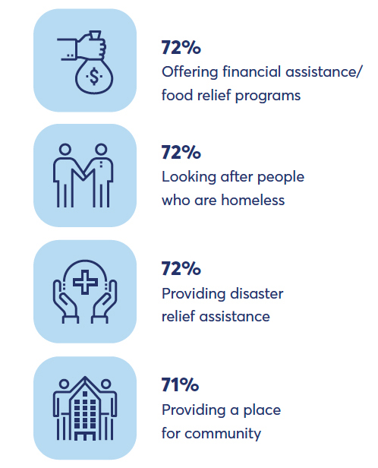
Climate resilience community value & license to operate

Slide 12
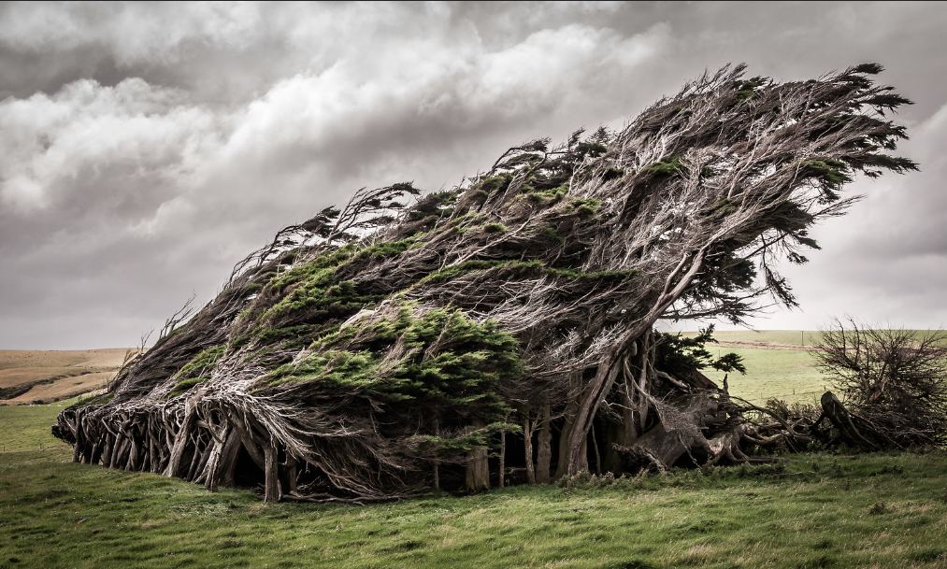
Spiritual value: Climate crisis, hopelessness & Christian hope

Slide 13
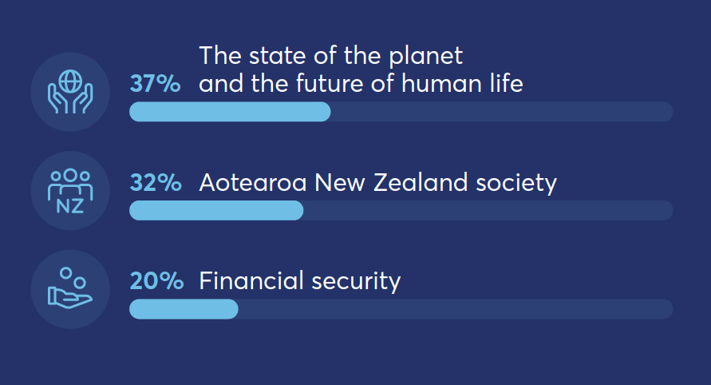
Hopelessness reported by people in
Aotearoa-NZ

Slide 14
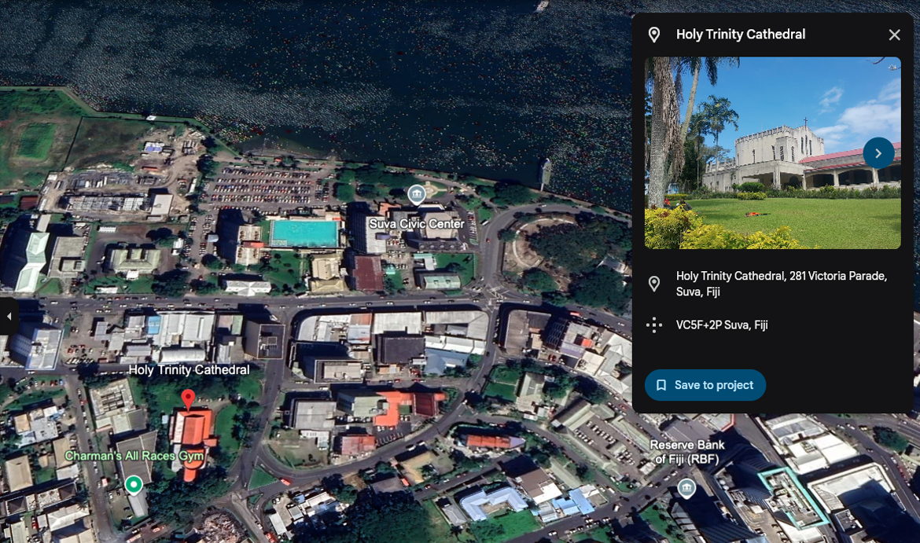
Our Diocese of Polynesia churches map risks in their local parish boundaries

Slide 15
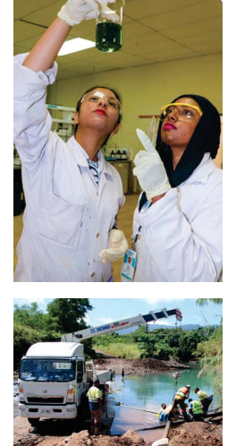
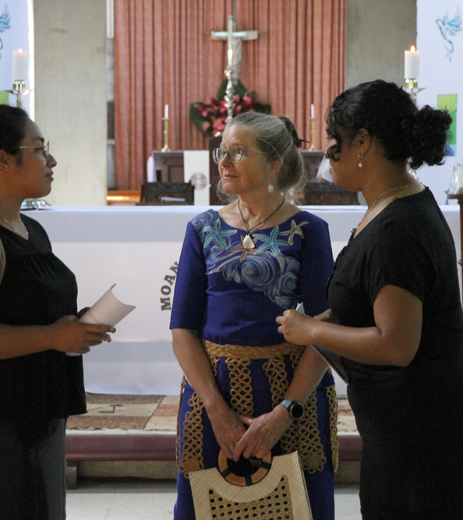
The Diocese of Polynesia consults scientists and works with Government and Civil Defence

Slide 16
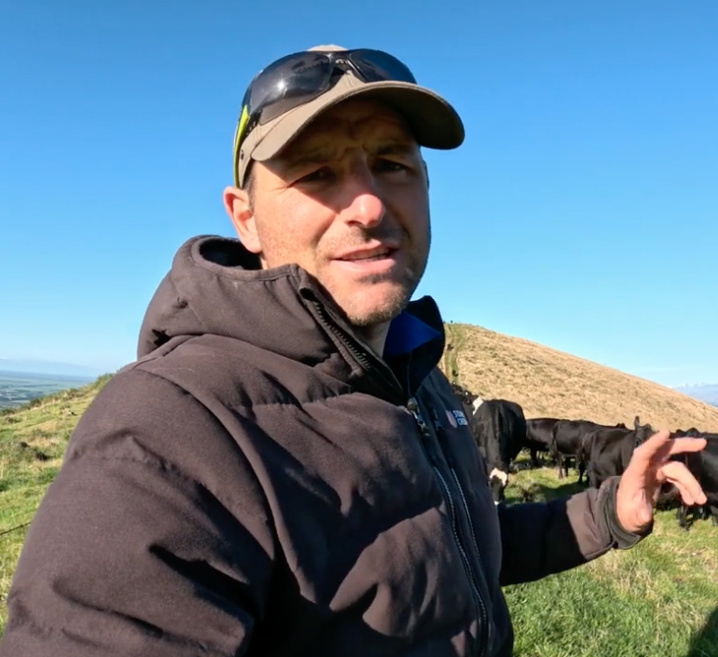
Environmental mitigation plans
Land management
Flood risk mitigation
Run off and waterway management
Shelter and riparian planting

Slide 17
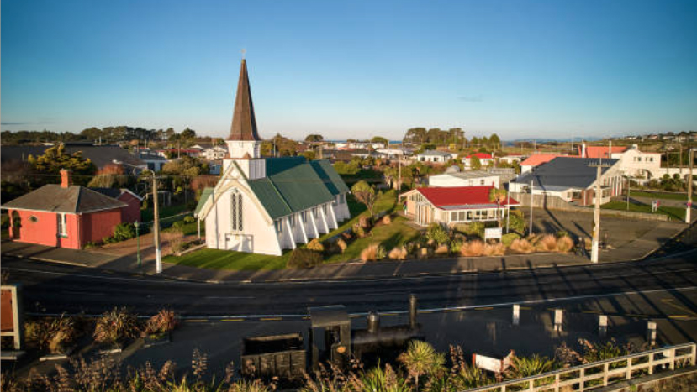
What are our safest assets?

Slide 18
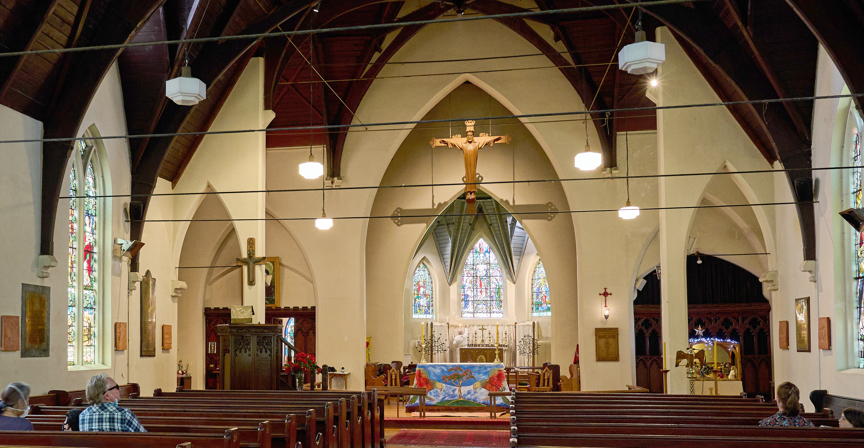
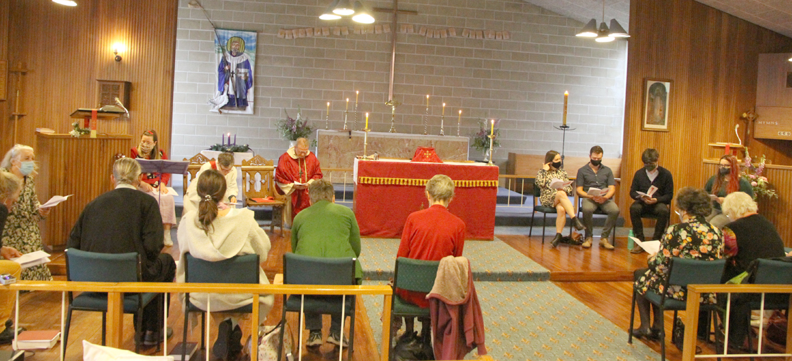
Dunedin North two worshipping churches + one former
All Saints’ 19th century
St Martin’s 20th century
St Thomas’s 20th century (secularised)

Slide 19
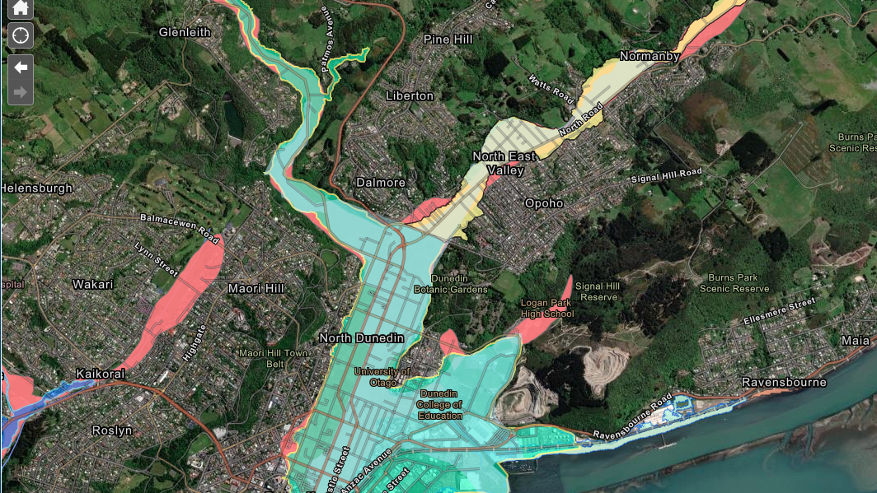
All Saints’ & North Road (St Martin’s)

Slide 20
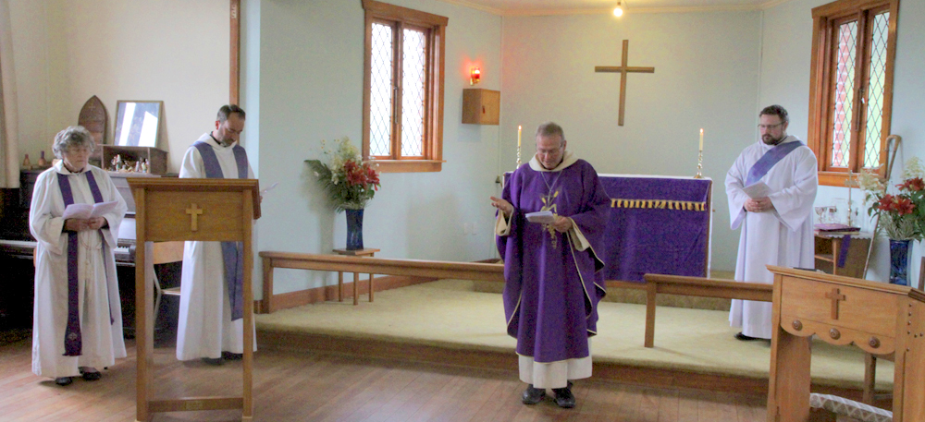
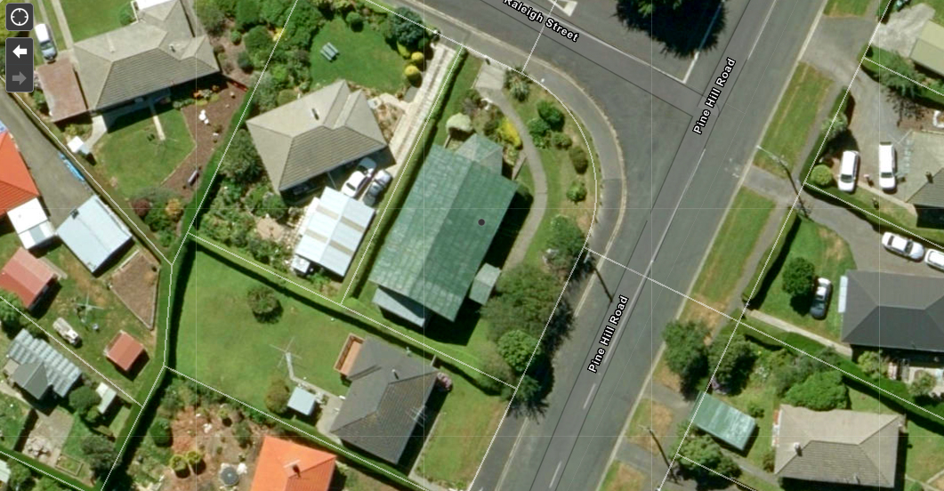
St Thomas’s Hall – our burden, or our salvation?
What is a resilient church
in the face of climate change?

Slide 21
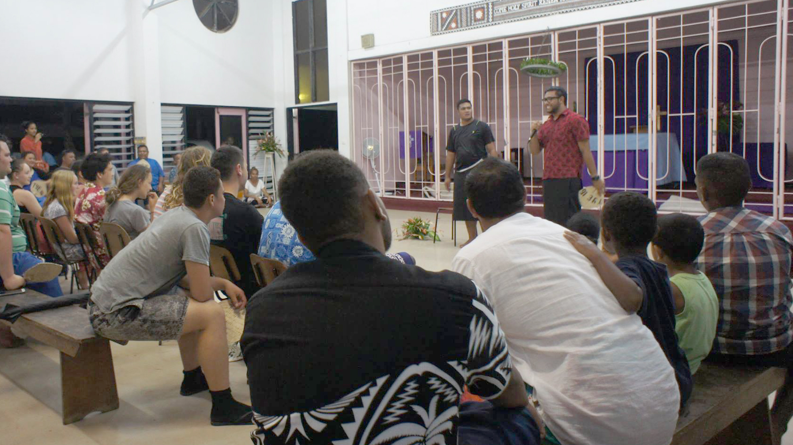
CIVA Training:
Track and record parish households
$$, water, health, power/fuel, food

Slide 22
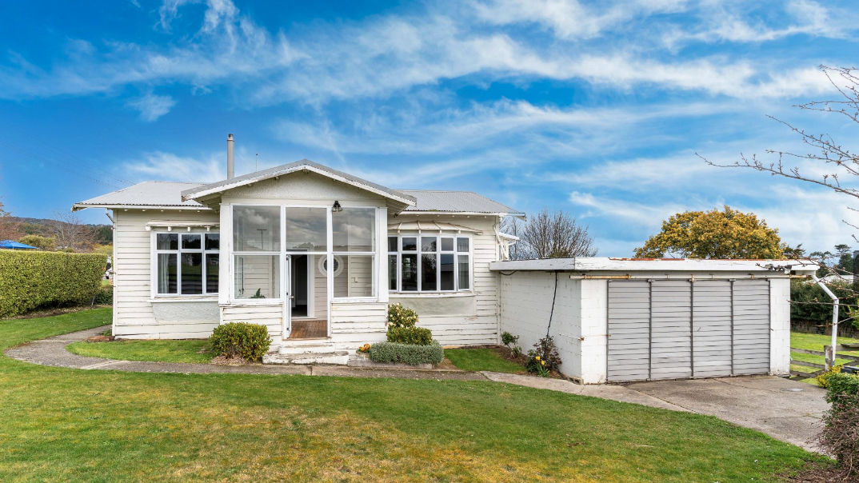
Physical addresses?
Mobile nos.? Readiness?

Slide 23
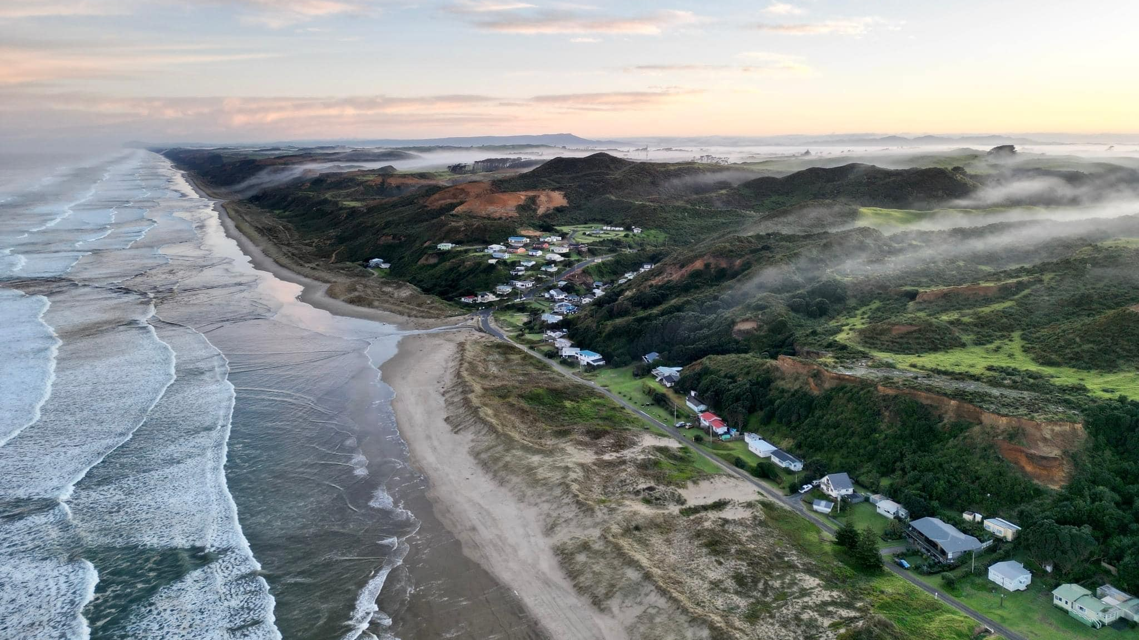
When Cyclone
Gabrielle hit Kaipara in
Northland

Slide 24
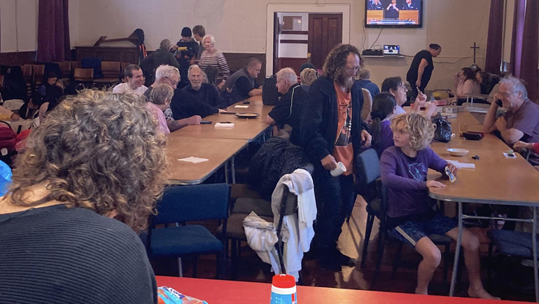
St Peter’s
Te Kōpuru in Dargaville

Slide 25
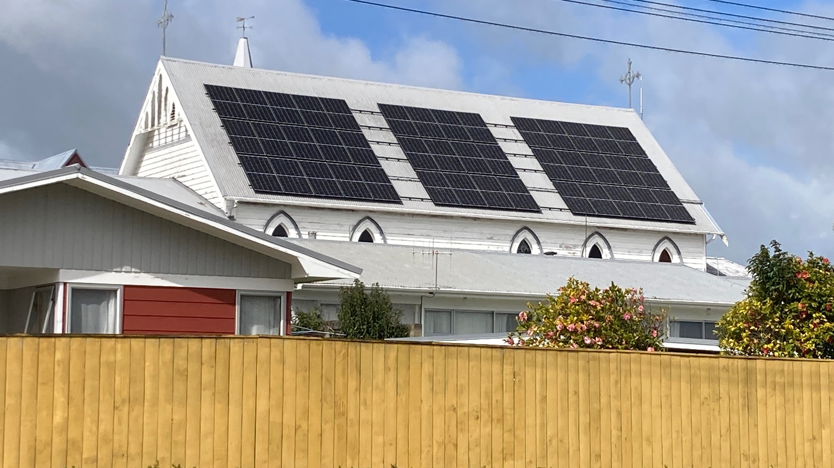
$100K panels & batteries
$0.00 electricity

Slide 26
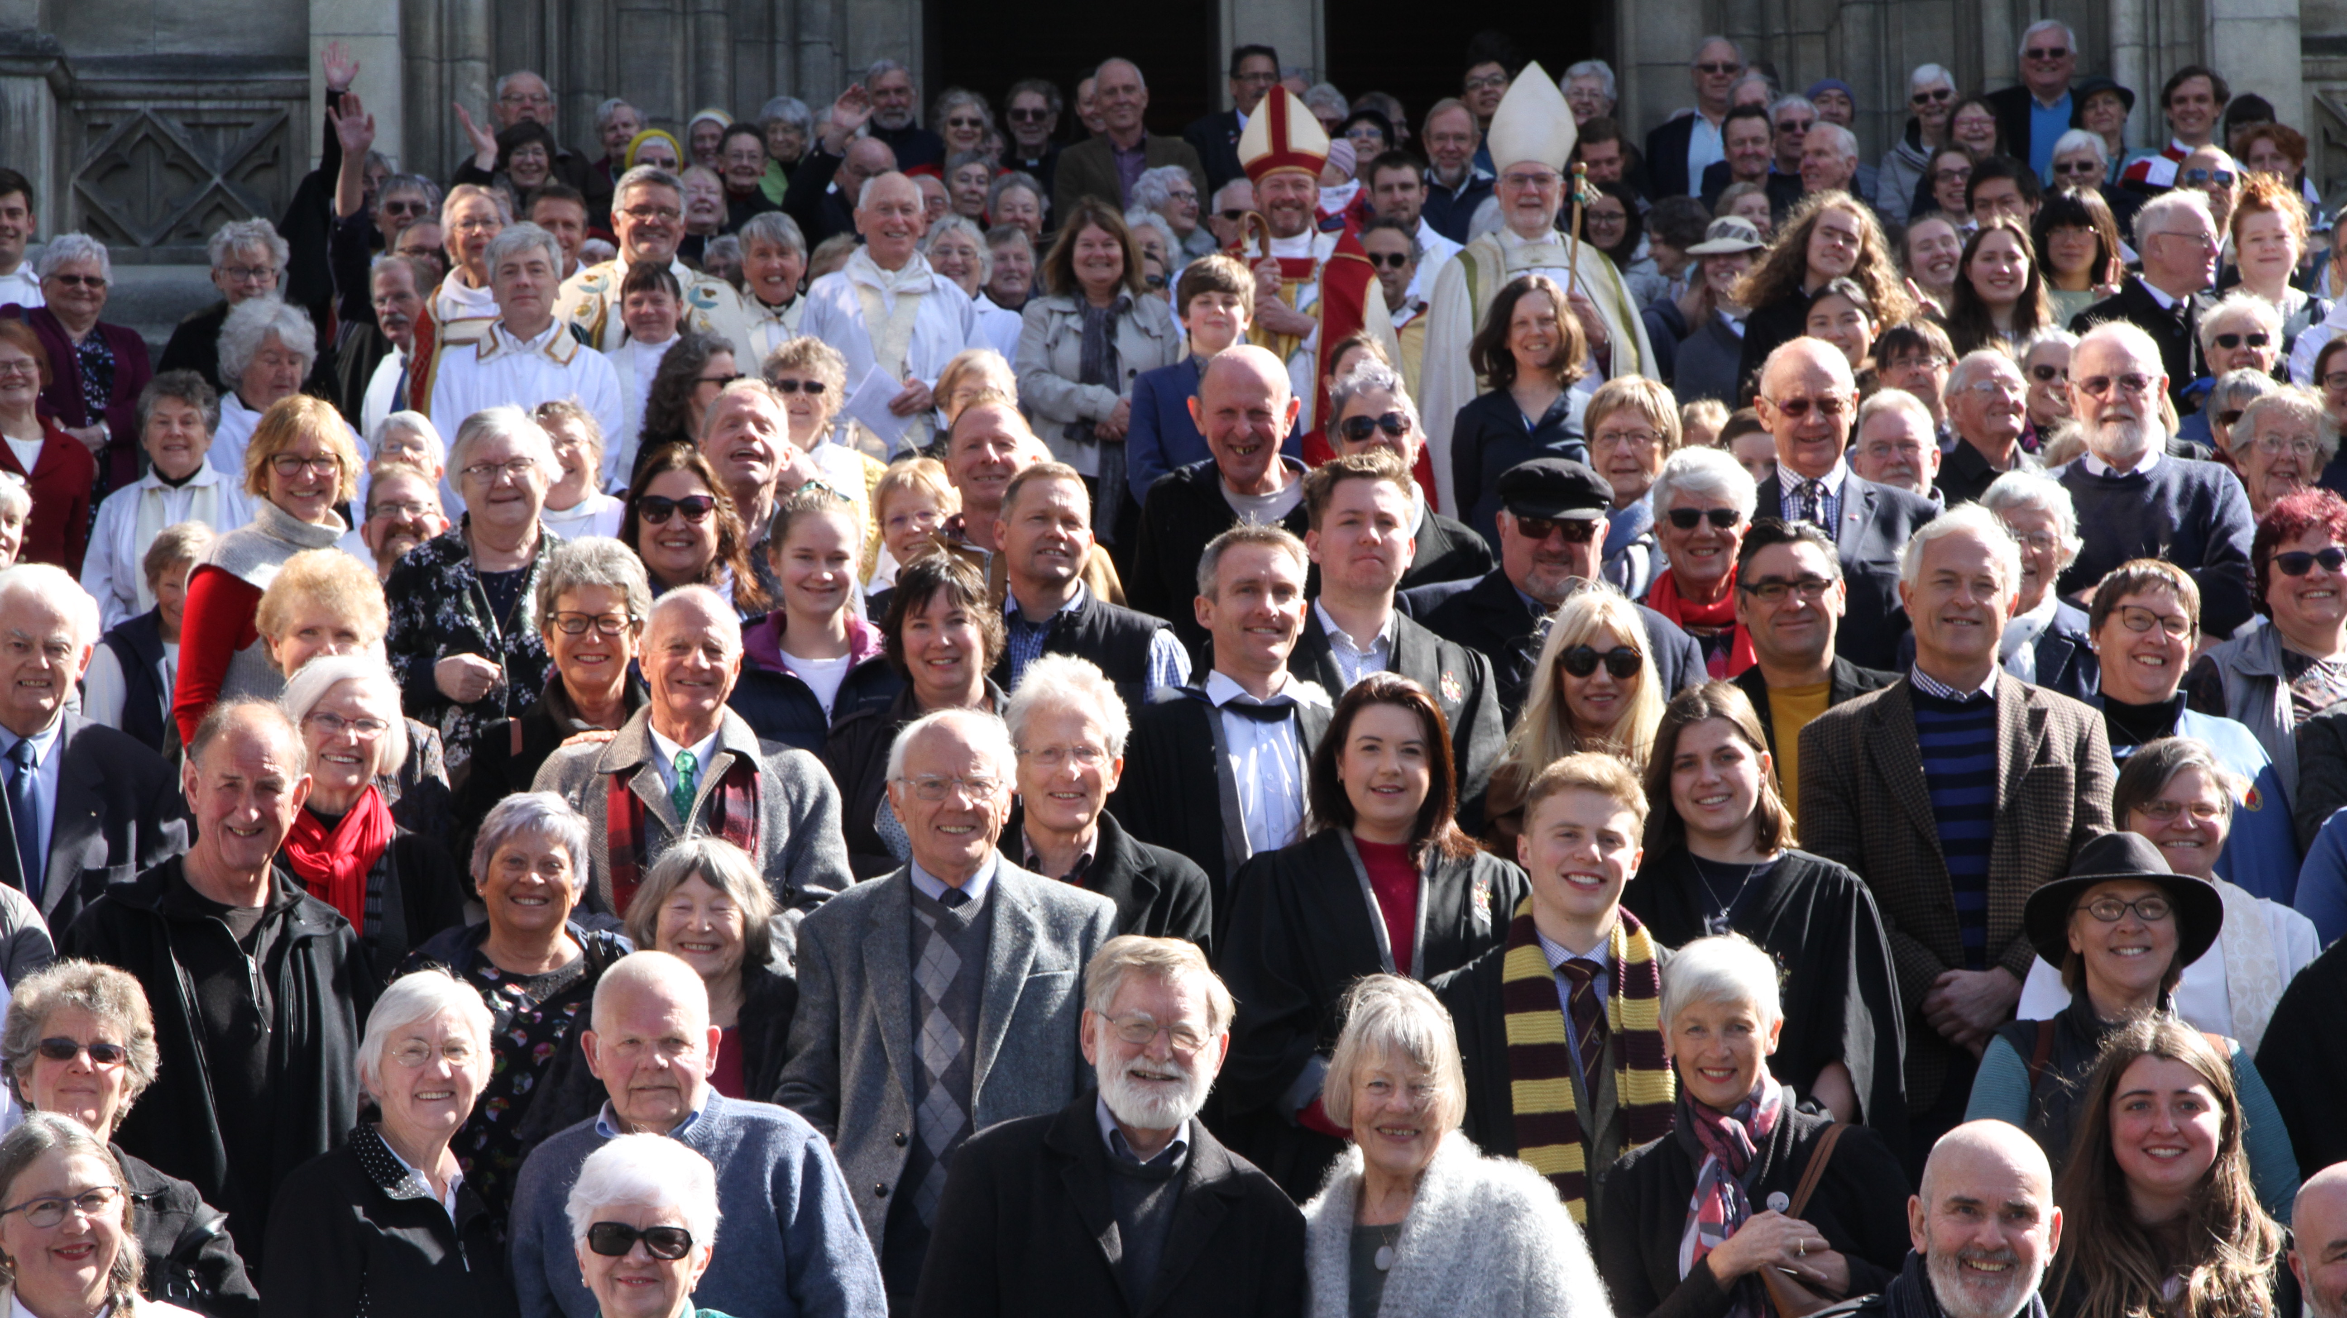
95% of us care for Creation
Opportunity for resilient church
Evangelism & connection
Caring for people/planet
Pure outdoor fun!
Resourcing community Resourcing church

