Slide 1
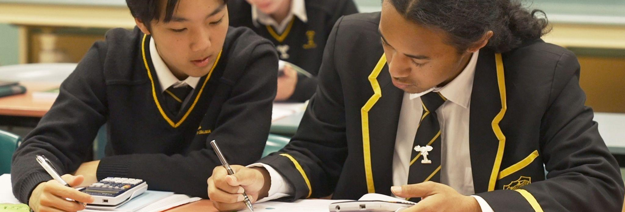

NCEA LIT/NUM CO-REQUISITE
INFORMATION FOR WHĀNAU- Wednesday 7 August

Slide 2

KARAKIA
E oha ki runga
E oha ki raro
Āna
“I greet those things from above
I greet those things from below
Yes I do”

Slide 3
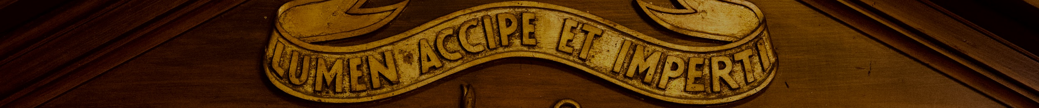
NCEA LITERACY AND NUMERACY CO-REQUISITES
PRESENTATION TO WHĀNAU
Health and safety:
Toilets are at the back of the AGC (turn right)
Evacuate to the turf if needed - follow a staff member
What is the NCEA Co-Requisite?
The Co-Requisite Assessments at WC
Content, format and conditions for the tests
Preparation and support - at school and at home
Readiness and results
Please stay behind at the end if you have questions about your young person’s particular circumstances.
Strategic Leadership Team (SLT)
Achievement and Attainment
Serena Lawrence
Jenna Vreeburg
Luci Lendrum
RECEIVE THE LIGHT AND PASS IT ON
TIAHO TE AO, TIAHO TE AO MĀRAMA
Notes:
LL

Slide 4
From 2024 onwards, in order for students to gain an NCEA qualification (NCEA Level 1, 2, or 3), they will need to pass two Literacy assessments (Reading and Writing) and one Numeracy assessment.
The co-requisites are assessed DIGITALLY, in an exam-type format called a Common Assessment Activity (CAA)
There are 3 separate CAAs: Numeracy, Reading, Writing
These are sat in school during the year, but are marked externally by NZQA
Each test will each take about an hour, but the assessments have no time limits.
THE NCEA LITERACY AND NUMERACY CO-REQUISITE
WHAT IS IT?
The co-requisite is a qualification.
It measures whether students have met the Literacy and Numeracy requirements for NCEA.

Slide 5
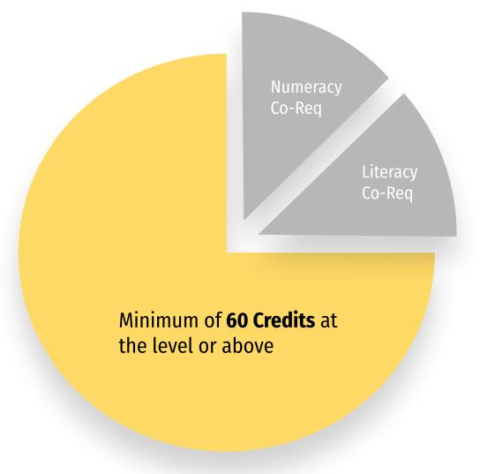
HOW DOES IT FIT WITH NCEA?
ARE THESE TESTS WORTH CREDITS?
NCEA qualification at ANY level

Slide 6
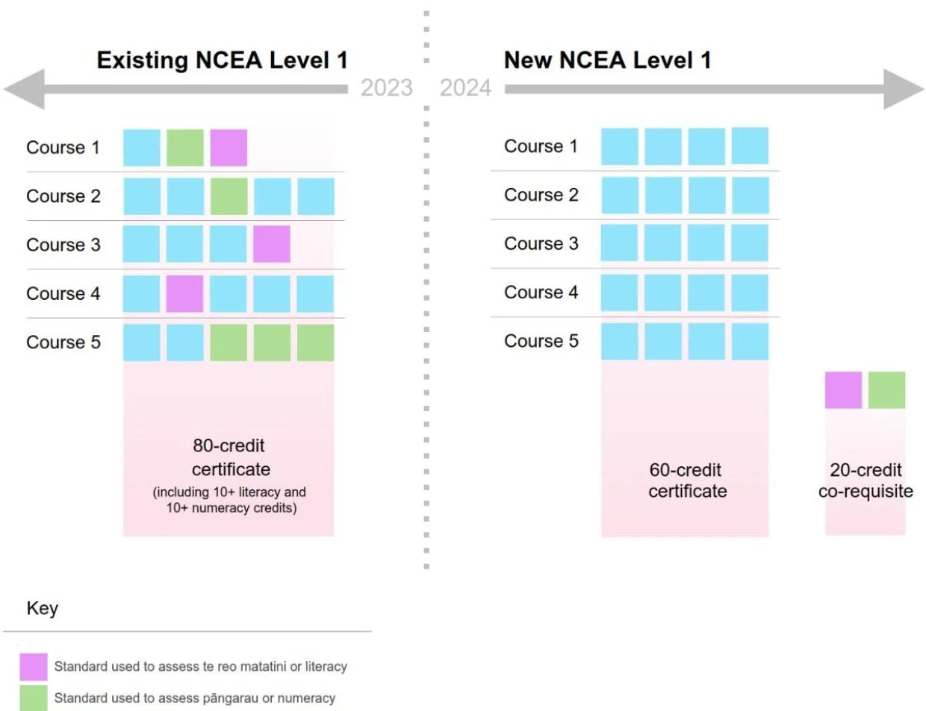
‘New Look’ NCEA
LITERACY AND NUMERACY CO-REQUISITE
Is assessed through separate standards. Students only need to meet this requirement once.
Old NCEA
New NCEA

Slide 7
THE NCEA LITERACY AND NUMERACY CO-REQUISITE
ARE THERE ANY OTHER WAYS TO MEET THE REQUIREMENT?
After 2026, the dedicated tests will be the only way to meet the co-requisite requirements.
Students who are fluent in Te Reo Māori may like to consider Te Reo Matatini me te Pāngarau, equivalent assessments in Te Reo Māori.
Contact us if this is an opportunity that might be of interest to your young person.

Slide 8
CAAs (Common Assessment Activities)
WHAT DOES THIS LOOK LIKE AT WC?
There are two ‘windows’ during the year, determined by NZQA, for students to sit the tests.
At Wellington College:
Year 10 students sit the Numeracy and Reading tests
Year 11 students sit the Writing test
Any student who needs to re-sit the test will do so at the next appropriate opportunity. This includes students who miss the test due to illness or other absence.
In 2024 our assessment dates are 12th and 13th September (Week 8)
Notes:
LL

Slide 9
These are formal tests sat in exam conditions. Students will not be able to communicate with each other during the test(s).
These are online / digital tests so it is essential that laptops are fully charged and functional, clear of VPNs and pop-ups, and have Chrome loaded as a browser. You can check that your device meets the specifications on the NZQA website. The Maths department will also take students through a ‘device check’.
All students can use text-to-speech for the writing and numeracy tests.
If you wish to utilise the text-to-speech function, you will need headphones.
Students can use calculators in the numeracy test. Paper and pens are available for any note taking or working.
Each test takes about an hour, but there is no time limit.
Special Assessment Conditions (SACs) are available as needed. This includes reading and writing assistance for students who qualify, for all tests.
THE NCEA LITERACY AND NUMERACY CO-REQUISITE
EXAM CONDITIONS AND EQUIPMENT

Slide 10
THE NUMERACY TEST
SUMMARY
The Numeracy standard requires students to master the mathematics and statistics content ideas at Level 4 of the New Zealand Curriculum AND interweave these content ideas with mathematical and statistical process ideas.
The Numeracy standard requires students to:
Formulate mathematical and/or statistical approaches to solving problems in a range of meaningful situations
Use mathematics and statistics to meet the numeracy demands of a range of meaningful situations
Explain the reasonableness of mathematical and statistical responses to situations
Notes:
JV

Slide 11
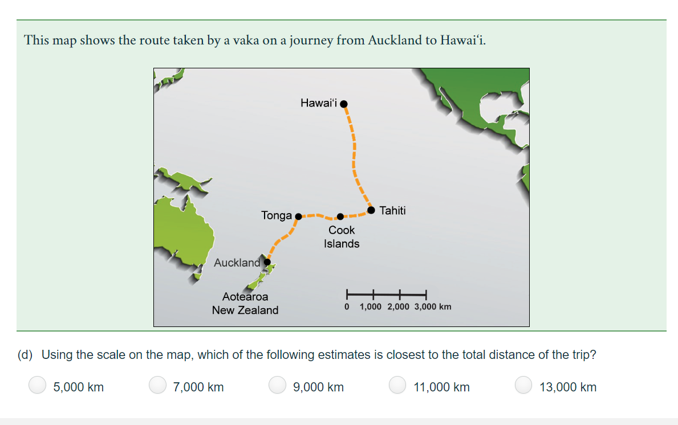
Notes:
JV

Slide 12
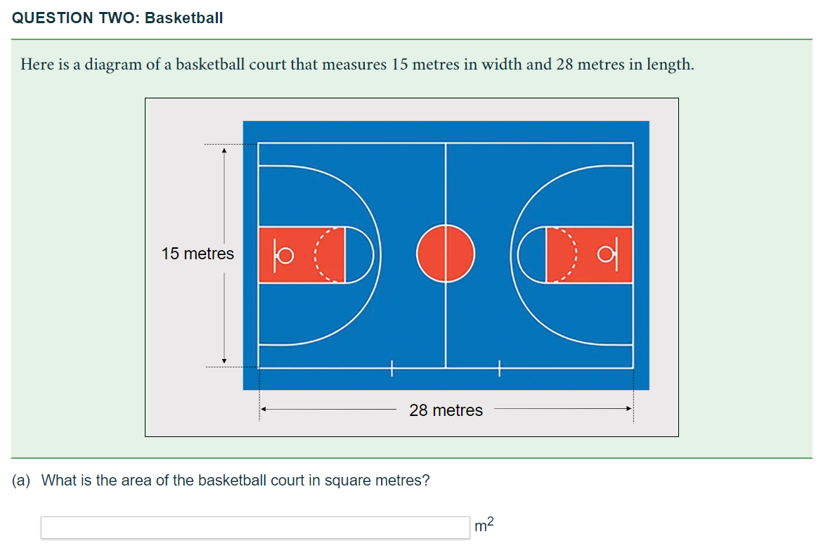
Notes:
JV

Slide 13
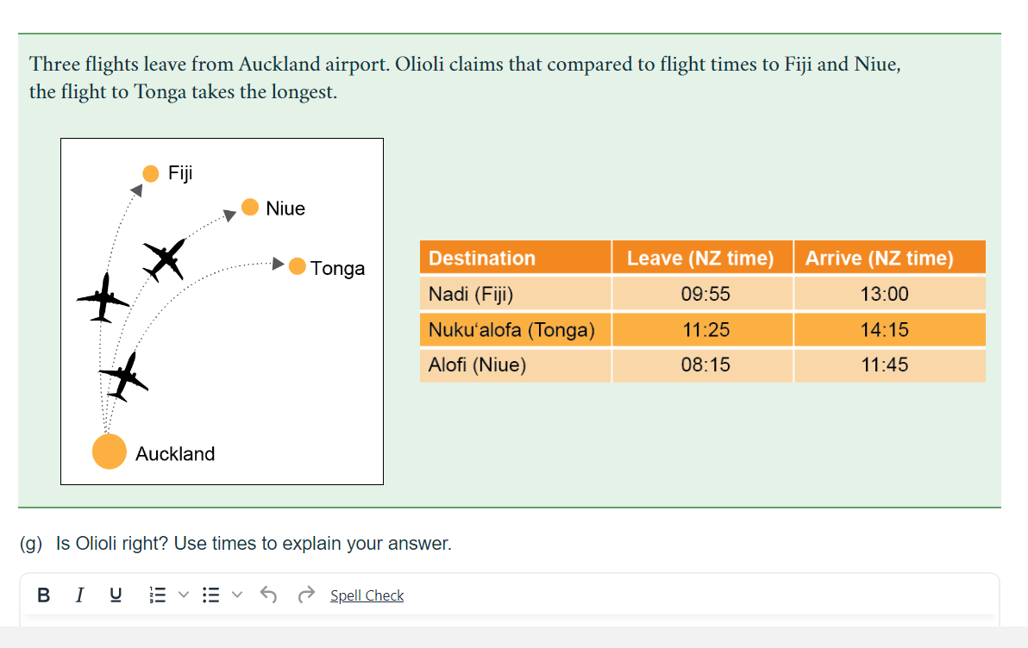
Notes:
JV

Slide 14
THE LITERACY TESTS
SUMMARY
The Literacy standard covers foundational literacy. This is approximately Level 4/5 of the New Zealand Curriculum.
Literacy is being able to read, write and understand language. The Literacy standards (Reading and Writing) require students to demonstrate the following skills:
Make sense of written texts
Read critically
Read for different purposes
Write meaningful texts for different purposes and audiences
Use structures in texts that are appropriate to purpose and audience
Write with technical accuracy, without intrusive errors in spelling, grammar or punctuation
General exam technique is key - We know that students need to take their time, and ensure they address all aspects of the question, particularly in the writing.
Notes:
SEL

Slide 15
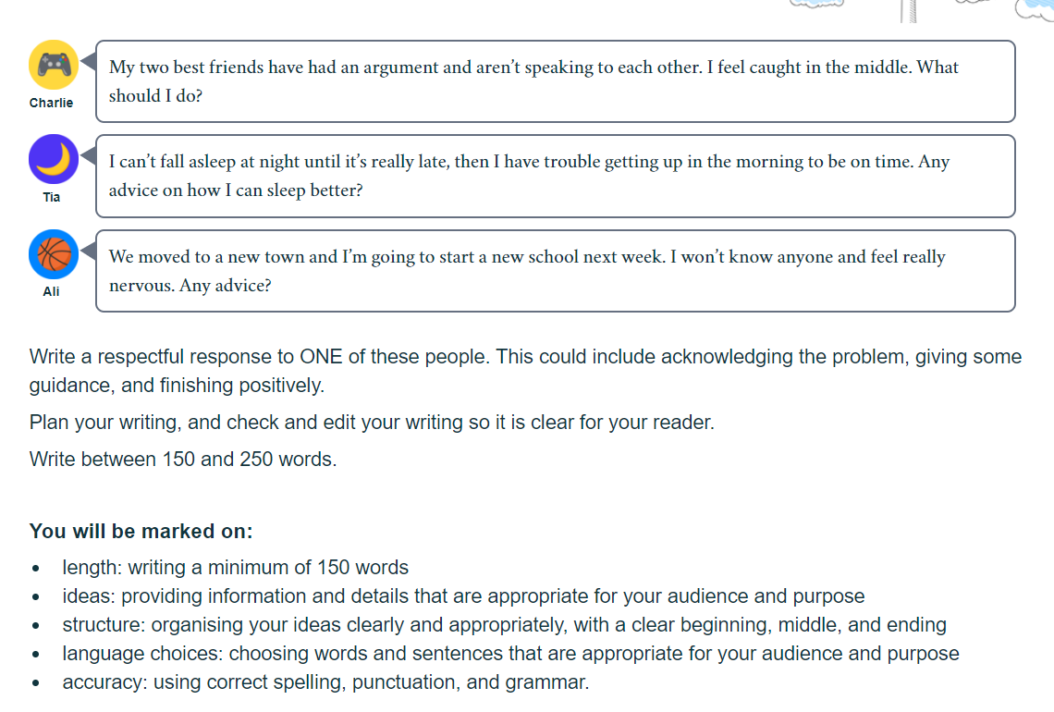
WRITING ASSESSMENT
Notes:
SEL

Slide 16
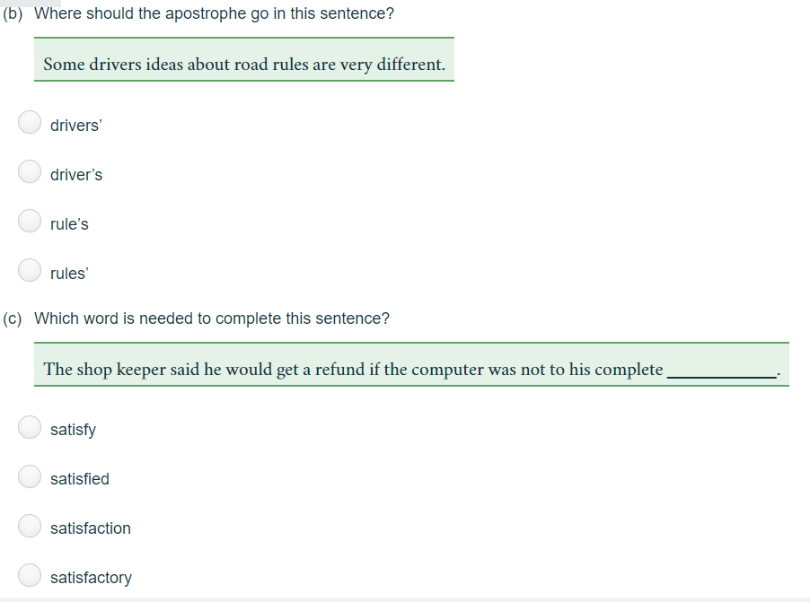
WRITING ASSESSMENT
Notes:
SEL

Slide 17
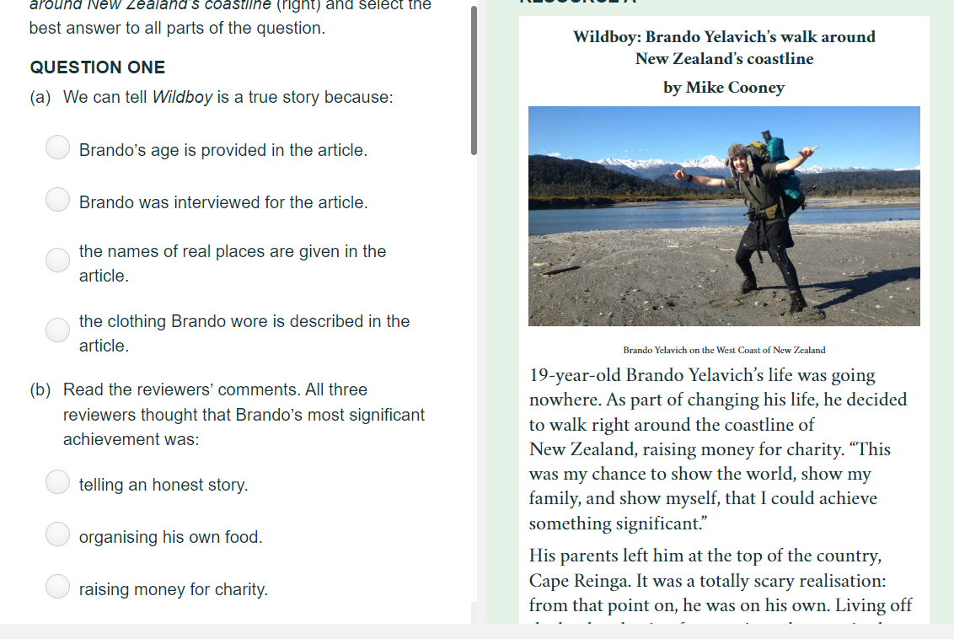
READING ASSESSMENT
Notes:
SEL

Slide 18
PREPARATION FOR THE TESTS
AT SCHOOL
Being in class is your child’s best chance at success.
Maths and English classes complete a range of practice activities from Year 9, with a particular focus in Year 10
Support with logging in to NZQA
SAC students are being supported in how to use assistive technology or an exam assistant
Support with exam technique.
Note - we do not complete full formal practice tests
Typically students who are operating at PAT Stanine 5 /Curriculum Level 5 are ready to sit the tests. Some students are ready to sit the tests earlier, but due to logistics we need to limit this to Year 10 and 11 students.
Notes:
LL

Slide 19
PREPARATION FOR THE TESTS
AT HOME
How do students login to NZQA?
They’ll need their NSN (National Student Number) which can be found on the portal.
Go to Learner Login at https://www2.nzqa.govt.nz/login/
Create a supportive environment: Establish a study space and celebrate progress and achievements.
Manage test anxiety: Equip your child with coping mechanisms to alleviate stress and enhance performance.
Support students to ensure that they have a suitable device, and can login to NZQA
You could:
Access past papers for practice, aiding familiarity with exam structure, question styles and text types. We will provide details about how to access the past papers.
Access the feedback in your NZQA login if you were not successful in passing the test last year.
Practise typing, if needed.
Notes:
SEL

Slide 20
SUPPORT FOR LITERACY
AT HOME
Encourage Daily Reading: Provide diverse reading materials and engage in discussions to improve comprehension.
Model Effective Strategies: Demonstrate good reading habits, like annotating texts, reading aloud to your child, pausing to reflect on the meaning of the text or asking questions about unfamiliar words
Build Vocabulary
Practise Active Reading
Consider author’s purpose. Read a text together and ask:
  What do you think is the main point?
  What does the writer want us to think? Why do you think that?
  Is this a reliable source? Why or why not?
Encourage accurate writing. Support students to correct spelling and punctuation errors. Communicate using accurate spelling, punctuation and grammar.
Notes:
SEL

Slide 21
SUPPORT FOR NUMERACY
AT HOME
Encourage Problem Solving & Explaining thinking: by asking questions such as, ‘so what made you come to that conclusion?’, ‘show me how you worked that out?’
Model Effective Strategies: Math problems are not always solved through knowing what to
calculate. Model other strategies such as drawing diagrams, pictures, or using series of lines/dots.
Build Vocabulary: Use math language where possible. There are many common math concepts
that with repeated exposure will commonplace in the mind of your student: area, volume and
perimeter, probability, right-angle, east direction, discount, G.S.T, scale, commission, parallel,
perpendicular, net, rotate, enlarge, deposit, withdrawal ….
Notes:
JV

Slide 22
PREPARATION FOR THE TESTS
JUST BEFORE / ON THE DAY OF THE TEST
Help students to check their exam timetable. This will be emailed to them.
Support them to arrive at school in plenty of time.
Do a device check. Make sure device is charged and ready to go.
Check they have anything else they need: calculator, headphones, drink bottle, etc
Remind about exam conditions and expectations.
Support students to get enough sleep and exercise, and that they eat well.
Students need to check that they can login to NZQA well in advance of the test. If they have difficulties logging in, they need to contact NZQA directly.
Notes:
SEL

Slide 23
Does Wellington College receive the student tests and feedback?
We only receive a consolidated feedback report. We do not get any test papers returned to us, nor do we see the feedback given to students on their NZQA Login page.
Like with other NZQA externals, students need to login to NZQA to see the results. We hope these will be available in December.
Students who don’t pass receive a brief feedback report highlighting their strengths and weaknesses.
What if my child attains Not Achieved grades?
There is no maximum number of times a student can sit the Common Assessment Activities. If a student does not pass one or more of the assessments, they will be able to resit these at the next available opportunity. They will only need to resit the tests they did not pass.
THE NCEA LITERACY AND NUMERACY CO-REQUISITE
RESULTS
Notes:
JV

Slide 24
Who can I contact if I have concerns about my child’s progress towards these tests?
Their Maths or English teacher
The HOD of Maths or English
The SLT responsible for administering the co-reqs:
  Serena Lawrence
  Jenna Vreeburg
  Luci Lendrum
Learning support (Deb Marshal, or senco@wc.school.nz)
What if my child is not ready?
There is no problem at all with choosing to sit the tests at a later date. We also have a small number of students who are using L1 standards to gain the required credits (note this is not possible after 2025).
What if my child needs special assessment conditions?
Remember that there is no time limit, and all students can use assistive technology in the Writing and Numeracy tests. If you think your child needs support beyond this such as an exam assistant, contact Learning Support.
THE NCEA LITERACY AND NUMERACY CO-REQUISITE
READINESS
Notes:
JV

Slide 25
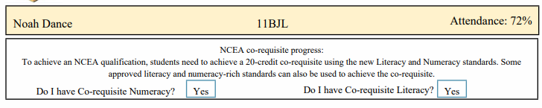
NCEA CO-REQUISITE SUMMARY
Learners will only be awarded an NCEA qualification once they have met the co-requisite. In the meantime, they can continue earning credits towards their qualification.
The co-requisite is assessed via a digital exam. It happens in the middle of the year, but is marked externally by NZQA.
Learners only need to complete the co-requisite once (but can attempt it as many times as they need to.)
There is no time limit and learners have full access to SACs if needed
We are carefully monitoring and supporting students, and will be in touch if we have concerns
Business as usual - no time off is needed to ‘study’ for these tests
Notes:
LL

Slide 26
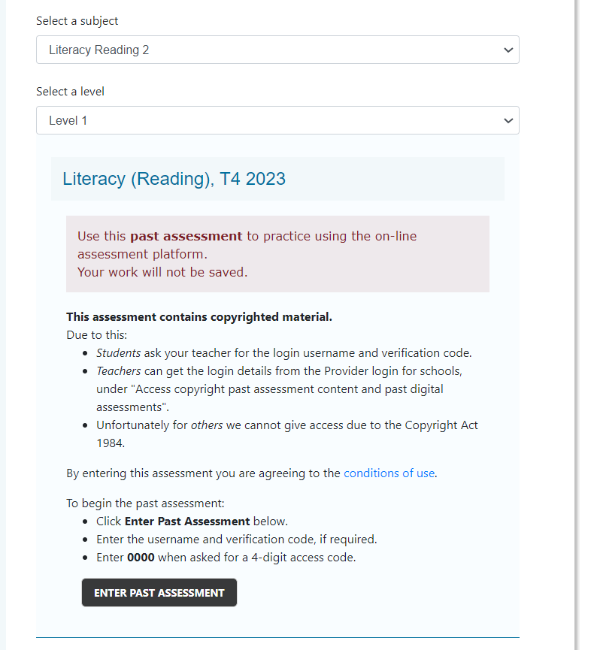
ACCESSING PAST PAPERS FOR PARENTS
Search: NZQA Find Past Digital Assessments
Select your desired assessment and ‘Level 1’
Enter past assessment.
When prompted:
NSN: View2024
Verification code: Tw3nty/24
The access code is 0000
Students can also access this in their NZQA Login
Students also have access to PDF versions in Google Classroom
NOTE - the past digital tests are NOT available during the exam period

Slide 27
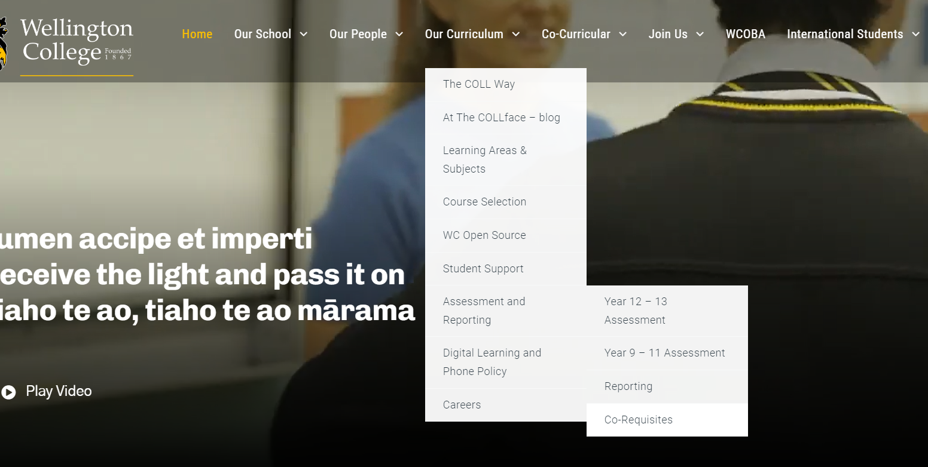
INFORMATION ON OUR WEBSITE

Slide 28
NCEA LITERACY AND NUMERACY CO-REQUISITES
KEY CONTACTS FOR SUPPORT
Subject Teacher
LAL Mathematics - Aaron Hawke a.hawke@wc.school.nz
LAL English - Sarah Marchant s.marchant@wc.school.nz
Deans - Wellbeing / pastoral support
Pacific/Māori Mentor Support – Debbie Tiatia, Piri Weepu
Peer tutors - contact the academic prefects or Cushla Thomson
Mental Health/Personal Issues - Guidance Counsellors - Lyndon Coppin / Jane Gray / Geoff Charles
Learning Support – Deb Marshall, SENCOs senco@wc.school.nz
Achievement & Attainment / Teaching & Learning DPs and APs: Luci Lendrum, Serena Lawrence and Jenna Vreeburg
RECEIVE THE LIGHT AND PASS IT ON
TIAHO TE AO, TIAHO TE AO MĀRAMA

Slide 29
KARAKIA
E oha ki runga
E oha ki raro
Āna
“I greet those things from above
I greet those things from below
Yes I do”

Slide 30

Ngā mihi
Mā te wā
Please stay if you have questions / pātai
Notes:
SEL

