Slide 1
Service at CBHS

Slide 2

Intro to SVA

Slide 3
How to sign-up to SVA ?
- Go to : https://volunteer.sva.org.nz/
- make an account using school email
- log your hours on SVA website.
- Earn SVA badges !

Slide 4
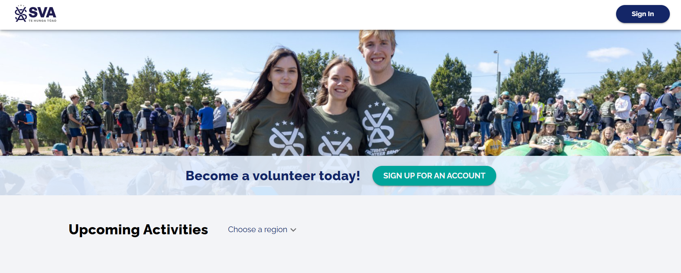
Go to the SVA website and click Sign-up

Slide 5
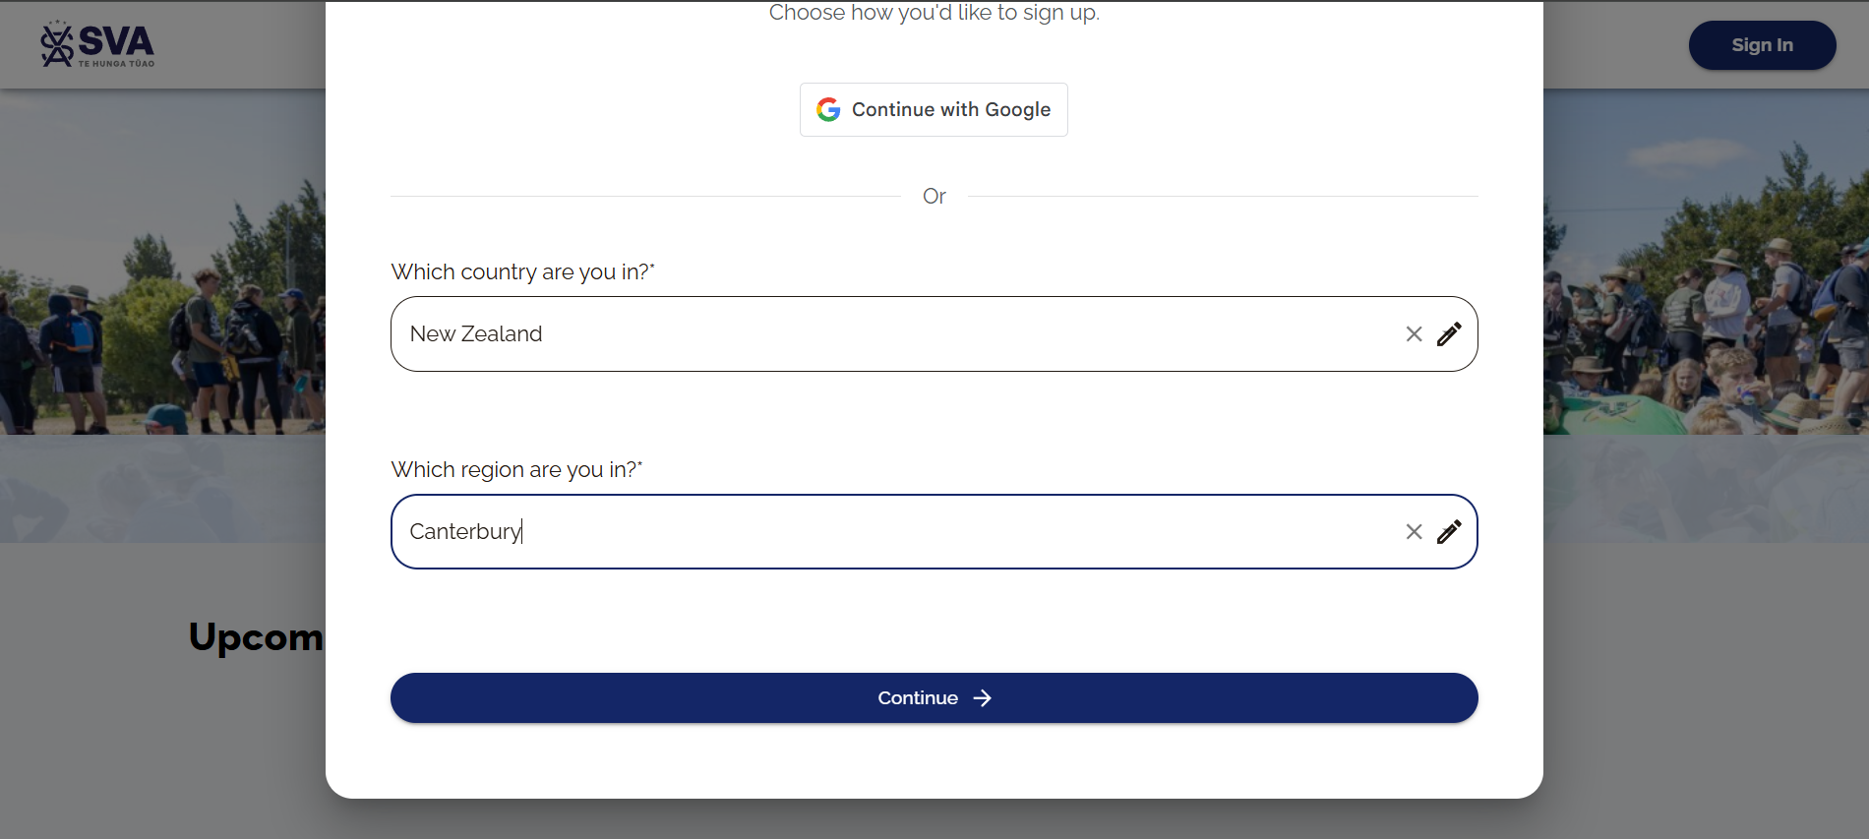
Enter Country and region

Slide 6
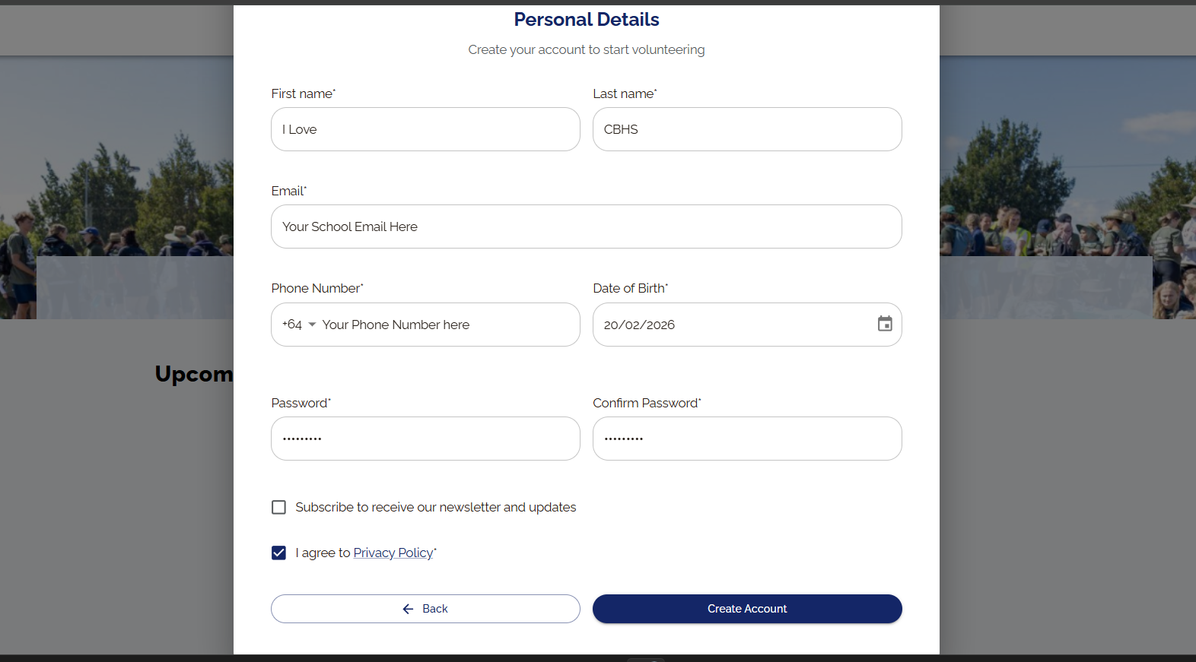
Fill in your student details

Slide 7
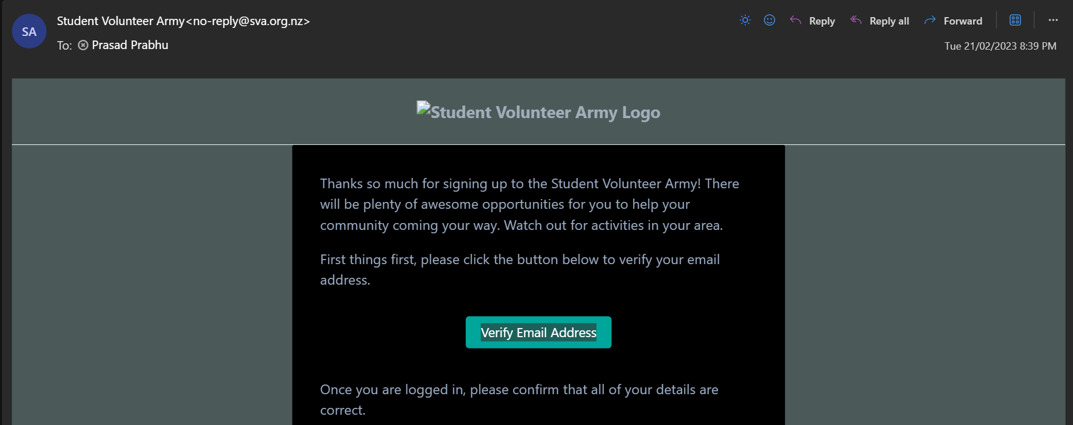
Verify your email and start logging hours !

Slide 8
Examples of service :
- Student librarian, Laptop refurbishment
- Attending club meetings,
- Tree planting, and helping out at events
- Help with fundraising at events
- Media team and technical team
- Volunteering for Cancer Society
- Wellies For Well-Being 10km walk
- Volunteering at CBHS uniform shop

