Slide 1

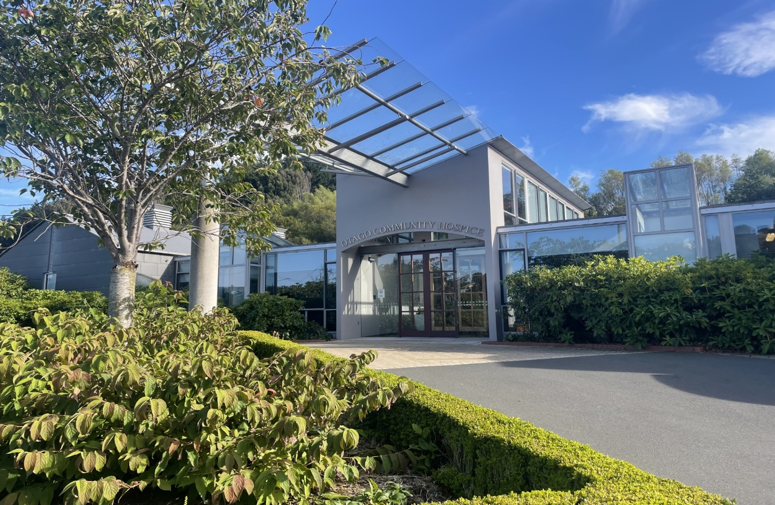

Otago Community Hospice
Community Team Model Review

Slide 2
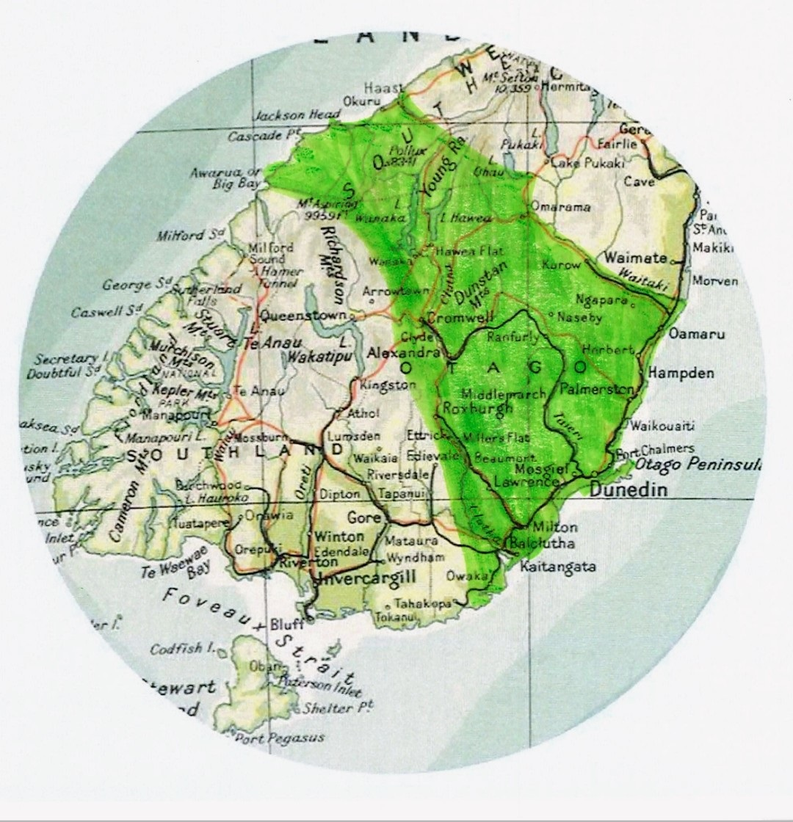
Setting the scene
Caseload: 1199 (2024-2025)
Admissions: 739 (2024-2025)
Rural /Urban: 39%/61%
32,000 SqKM/ 400km across (5hr drive)
High rurality rankings (Geographic Classification for Health)
Furthest from a tertiary hospital in New Zealand

Slide 3
Emerging issues
Small project – part of bigger strategic work
Improving access for patients
Managing increasing demand within current resource constraints
Managing risk around staffing and cover
Allocating resources wisely – making best use of expensive resource
Preparedness for regional work and national model of care adoption
General lack of opportunity to showcase improvement projects

Slide 4
Background
OCH historically provided community care coordination
In 2023 we undertook a review of services and commended an Extended Care Model
In Jan 2024, OCH assumed urban domiciliary care from District Nursing
Outcome: positive feedback from patients, whānau, and stakeholders
Comprehensive review conducted (Aug–Sep 2024)

Slide 5
Extended Service Review Findings
Internal and external feedback from Review highlighted:
Value of Care Coordination: importance of personalised care
Service continuity challenges: unplanned leave, extended visits → service gaps
Staff overwhelm/burnout: high caseload pressure
Boundary uncertainty: urban east boundaries and service differences

Slide 6
Extended Service Review Recommendations
Develop a whānau training module for ‘leaking legs’
Expand geographic boundaries
Develop a paliative wound assessment tool
Transition to a team based model
Intergration of extended services into BAU

Slide 7
Purpose and Scope of Community Model Review 2025
Focus on Recommendation 4: Transition to a Team-Based Model for Care Coordination.
Objectives:
  Improve service consistency
  Ensure equitable workload distribution
  Enhance overall efficiency of the Care Coordination service

Slide 8
Starting Point
Two urban teams | 8 Nurses
Oriwa: Total 74 patients/ 2.8 FTE/2.6pts per 0.1 FTE
Kikorangi: Total 59 patients/ 2.2 FTE/2.6 pts per 0.1 FTE
(Calculate 3 patients per 0.1 FTE)

Slide 9
Staff Engagement
Strong Feelings → Fear of loss of autonomy/ concerns of continuity
External facilitator-led workshops → Team Charter and domiciliary care solutions
Workshops incorporating Marie Curie Model → float shift and team reconfiguration
Identified training needs → Often individualised

Slide 10
Rationale for Change
Transition from individual caseload to team-based approach
Anticipated benefit:
  Improved service consistency and continuity
  Equitable workload distribution
  Enhanced collaboration and flexibility
  Staff learning and growth in community nursing roles

Slide 11
Recommendation – team structure
Two-team structure
Care Coordinators: 2 per team per day, 08:30–17:00, VIP schedule allocated
Float Role: 1 per day, 10:30–19:00, flexible coverage across teams
Phone Triage Role: 1 per day, 08:30–17:00, manage calls, referrals, liaison

Slide 12
Recommendation – Complex Care List
Supports up to 12 high-need patients at a time
Nursing assessment prior to admission
Daily assessments/follow-ups determined by team lead
Reviewed daily at morning MDT meetings
Medical review within 7 days if not previously done
Kowhai at Home services included (subcutaneous training)

Slide 13
Recommendation – referral and allocation
Referral process unchanged
Patients allocated to teams (not individuals)- 3 visits per day per nurse
Geographical review optimises efficiency and reduces travel

Slide 14
Recommendation – ‘follow ups’
Structured system ensures tailored, consistent care- based on Phase of Illness
Clinical administration and reception support follow-up bookings

Slide 15
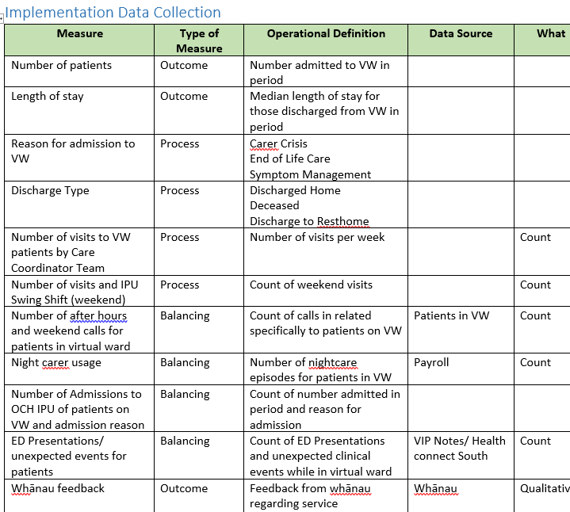
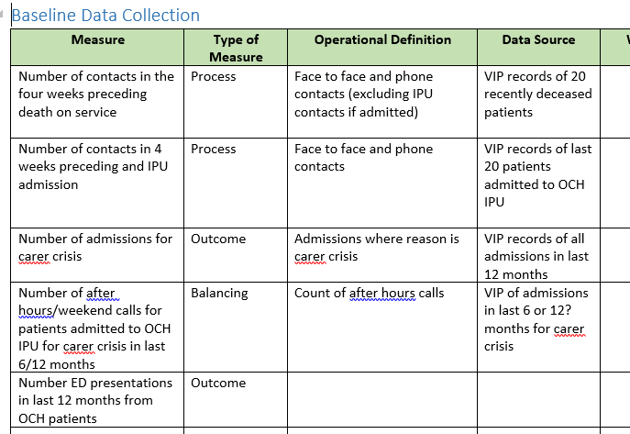
Measurement and Data Collection
Detailed data collection plan established prior to the implementation of the new community model, included Outcome, process and balancing measures

Slide 16
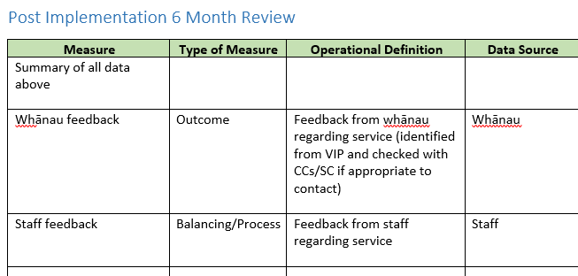
Measurement and Data Collection
Baseline data collected (Jan/Feb 25)
6 month post implementation data collected (Jul/Aug 25)
Qualitative data collated. (resulted in some minor changes to streamline booking processes)

Slide 17
Results

Slide 18
Results

Slide 19
Results

Slide 20
Results

Slide 21
Staff Feedback
An aspect that is working well is the shared responsibility within the team. I find it reassuring to know that patient care and follow-up are not solely dependent on me or any one individual.
I do not feel like I take work home with me anymore - this is a huge plus!
Working in teams works well, sharing patients, so we all get to know them is beneficial for patient care.
It is good to be working in teams. Having the float works well. Sharing the load/responsibility with challenging and deteriorating patients is beneficial.

Slide 22
What’s next?
Further work in preparation for the national model of care
Enhanced rural strategy – partnerships, clinical leadership
Te Waipounamu view on service delivery across a population rather than agency by agency
District wide and regional clinical governance frameworks
Enhanced strategy for Māori
Suggest a nation wide celebration of quality initiatives

Slide 23
Questions?

