Slide 1

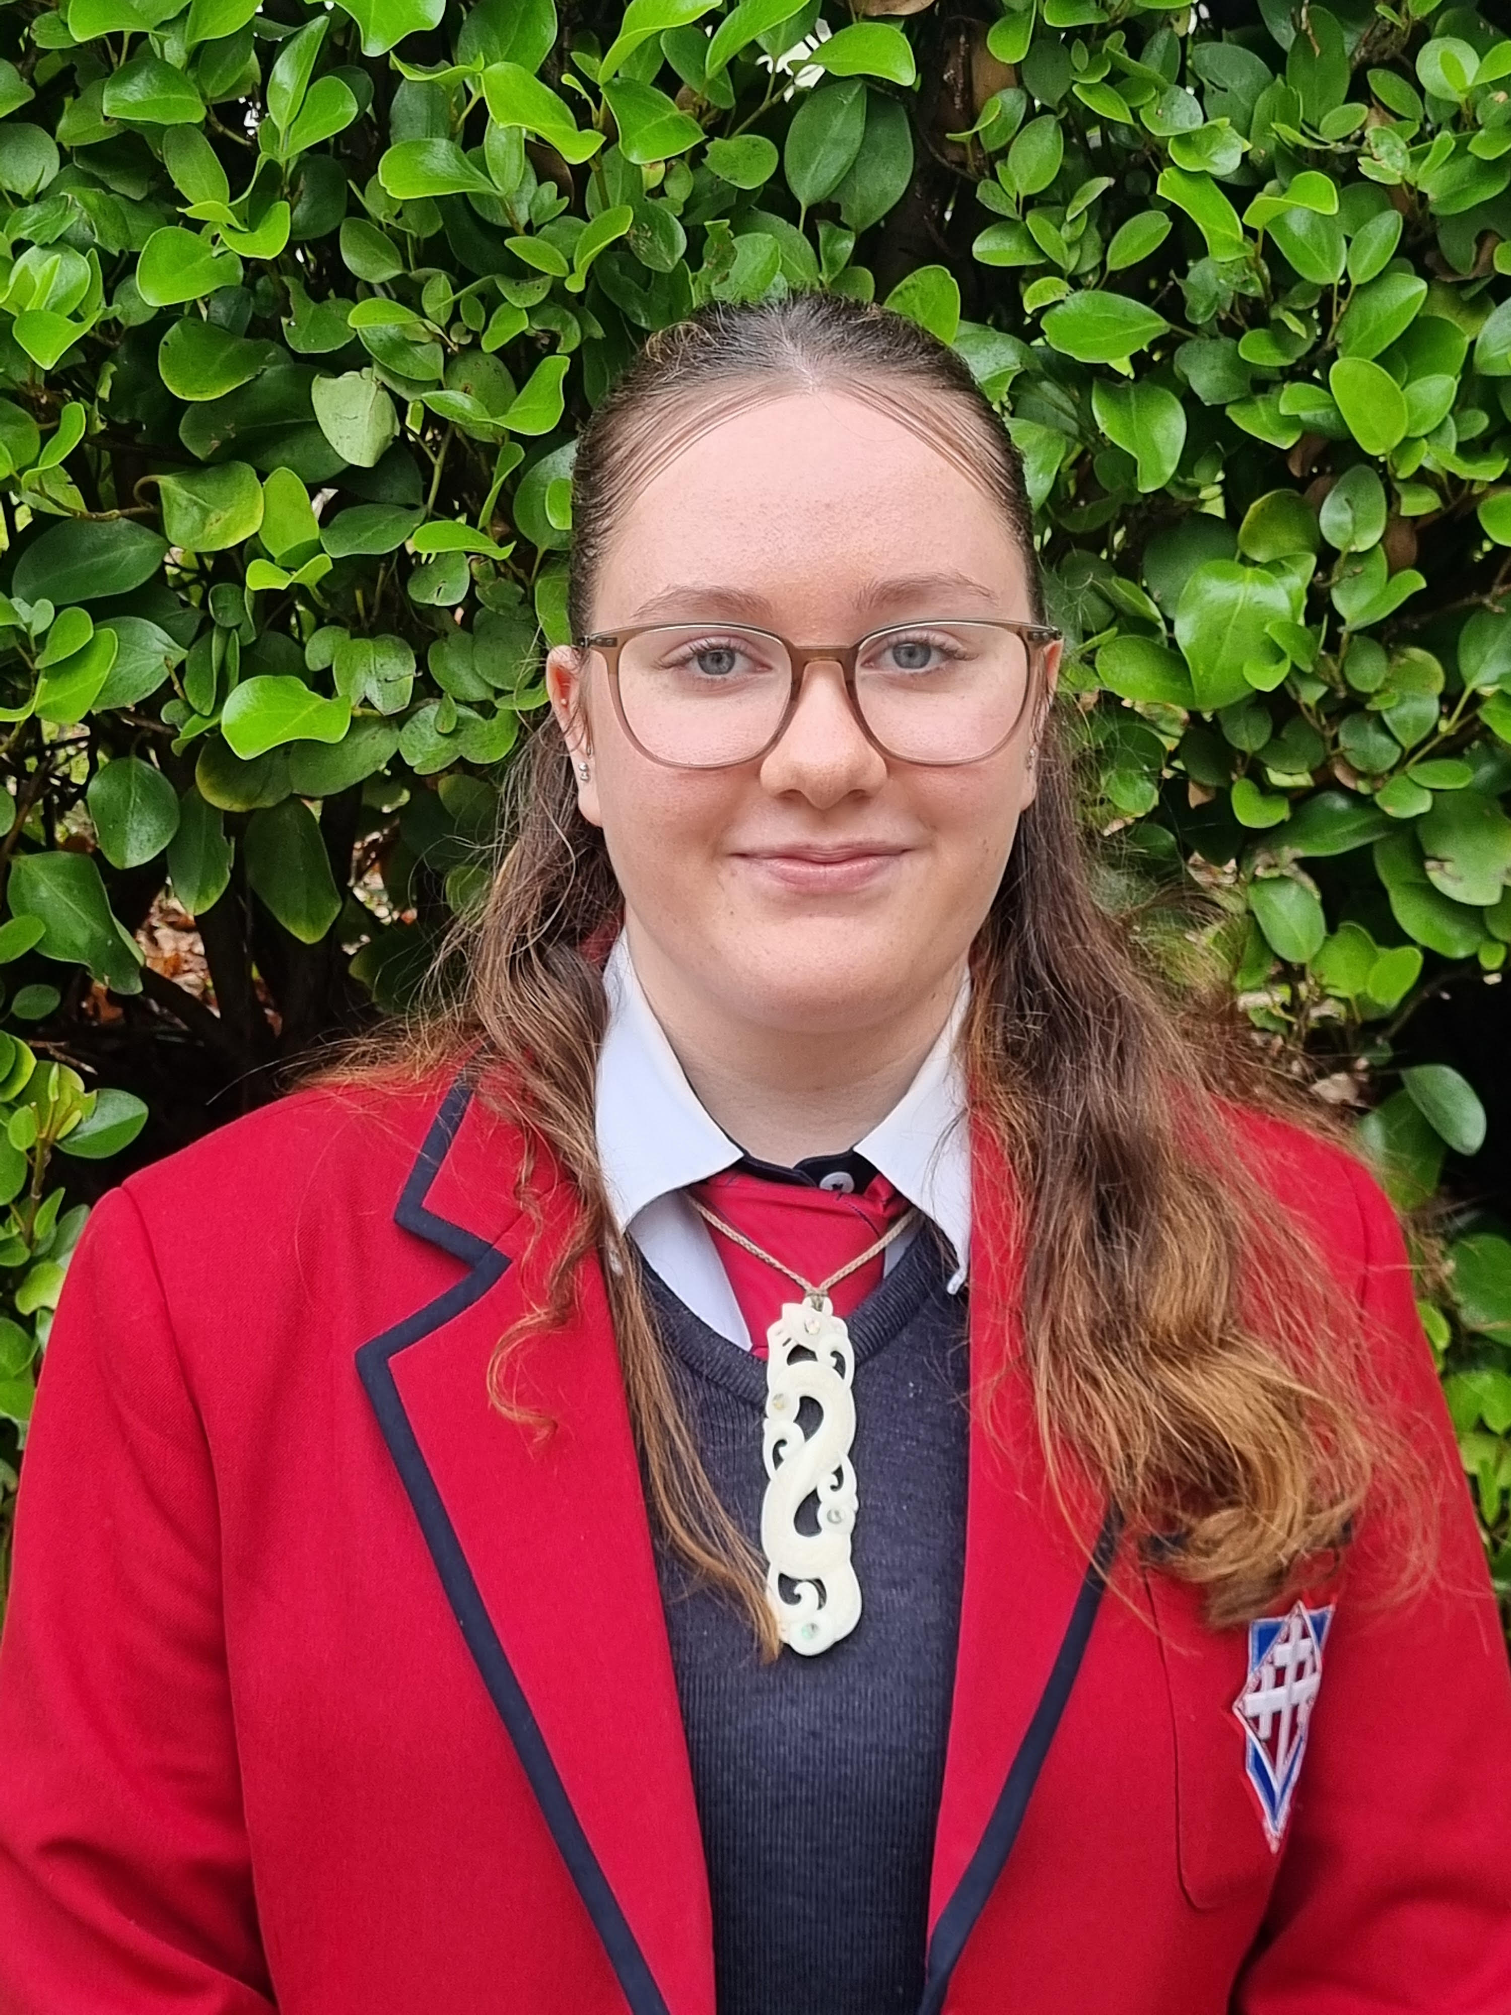
Teina
Teina
Manaia Batson
Ngāpuhi, Ngāti Porou
  Kapa haka Member & Awarded Merit at Cultural Awards
  School Choir Representative
  Excellence Te Reo Māori NCEA Level 1 2025
  Student Volunteer Army
  Honours for Junior Māori leadership 2025
  Year 9 Cultural Leader for Māori
  Te Pae Māhuri Māori Council Member
  Aspirations to become an
  Orthodontist
Notes:
Trinity Catholic College

Slide 2
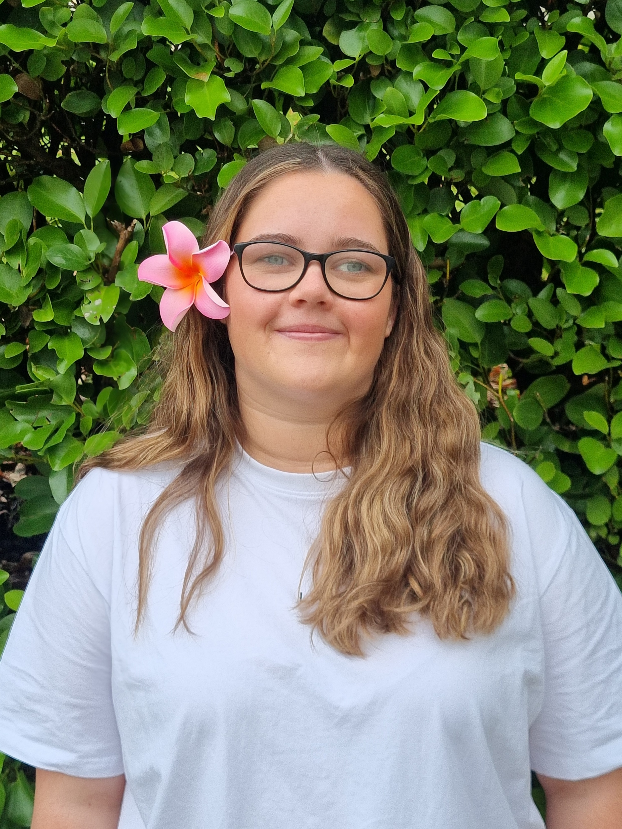
Tuakana
Tuakana
Riley Matthews
Kāi Tahu
  Kapa Haka Representative
  Southern United Football U15 representative
  Level 1 and 2 Merit Endorsed
  Senior A Girls Volleyball Member
  Committee, Sports, & Cultural/Arts Representative
  Diligence awards PE, Māori and Drama
  Plans to Study Bachelor of Education
  Cultural Prefect
  Dunedin City Royals AFC
  Member 12 years
Notes:
Trinity Catholic College

