Slide 1
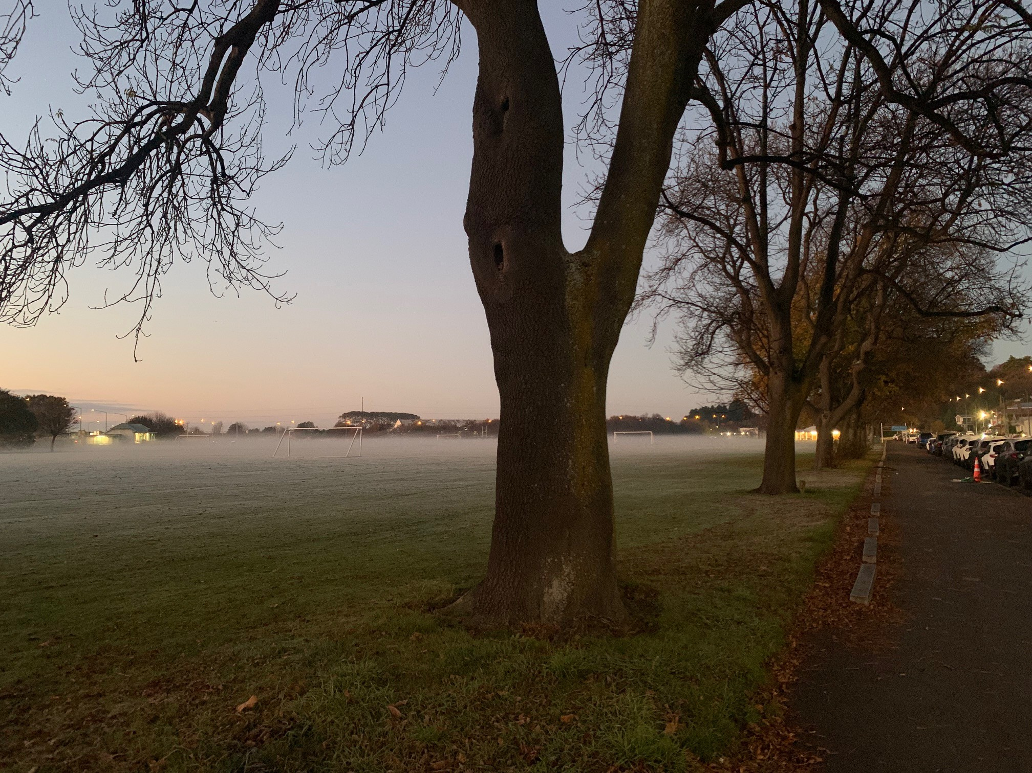

The Scattered People of the Good Shepherd
28 June 2026
Bishop Kelvin Wright
Jeremiah 28: 5-9
Romans 6: 12-23
Matthew 10: 40-42

Slide 2

The Scattered People of the Good Shepherd
We will check in with each other from 9.45 am for any prayer requests.

Slide 3


Slide 4


Slide 5

For individual reflection and contemplation:
What questions are this message and readings asking you?
What thought struck you most in the message today?

Slide 6


Slide 7
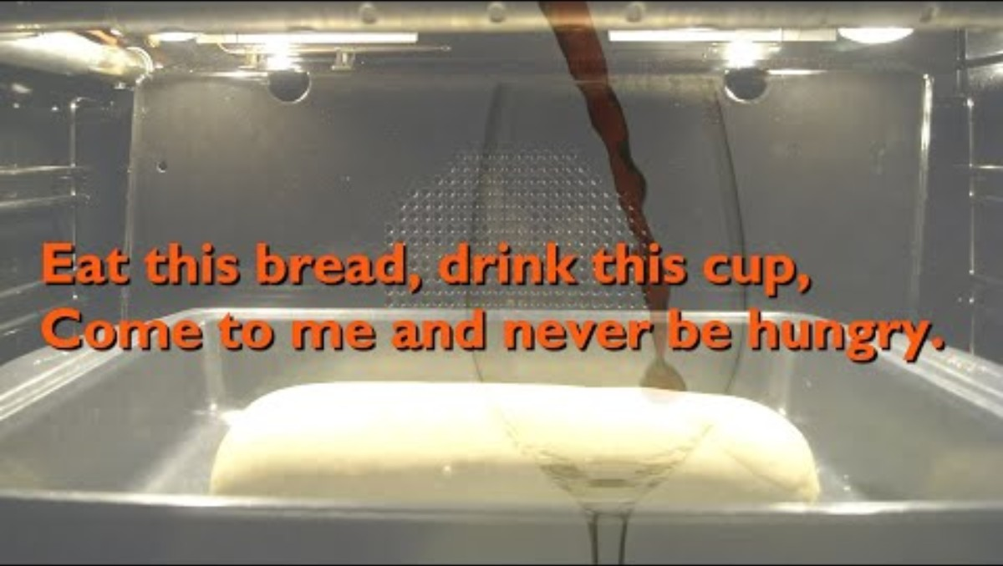

Slide 8


Slide 9


